Slide 1


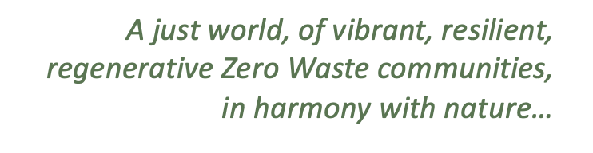
Moving Policy Beyond the Current EPR system

Slide 2
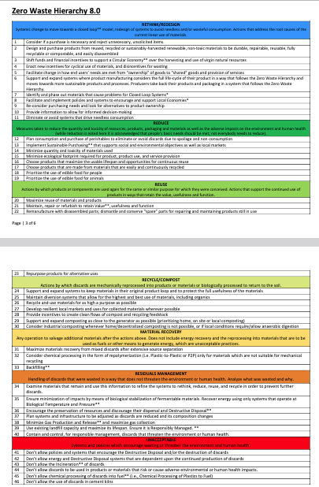
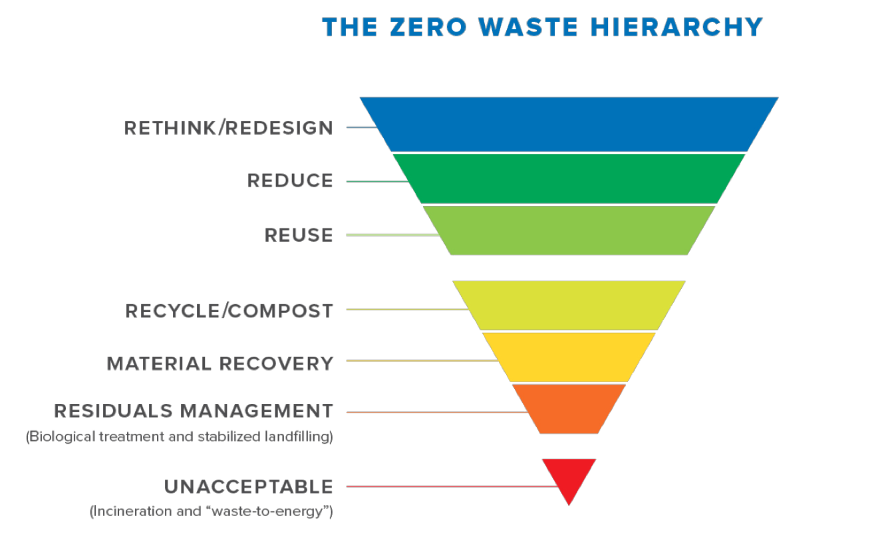
Zero Waste
The conservation of all resources by means of responsible production, consumption, reuse, and recovery of products, packaging, and materials without burning and with no discharges to land, water, or air that threaten the environment or human health.
2018, Zero Waste International Alliance
www.zerowastebc.ca

Slide 3
State of Waste
Data spotty
Diversion increased
23% increase per capita in generation
37% ↑
59%
44%
Notes:
Note that 2 million tonnes are inorganic building materials like concrete and asphalt. Without that diversion is at 41%

Slide 4
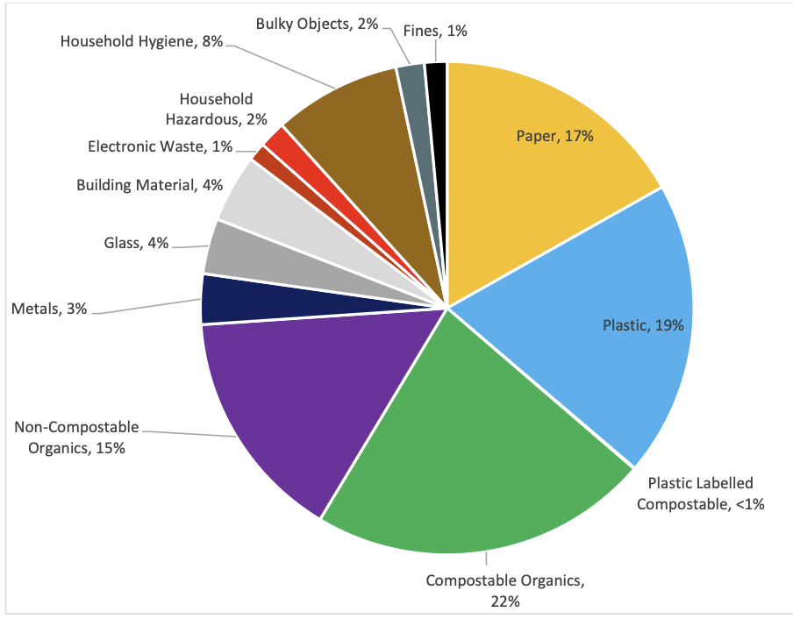
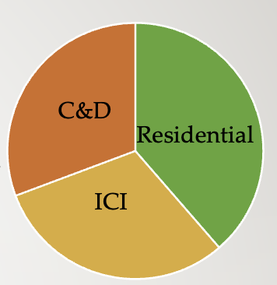
What is in that waste and where does it come from
Source: Metro Vancouver waste composition 2024
Notes:
Source

Slide 5
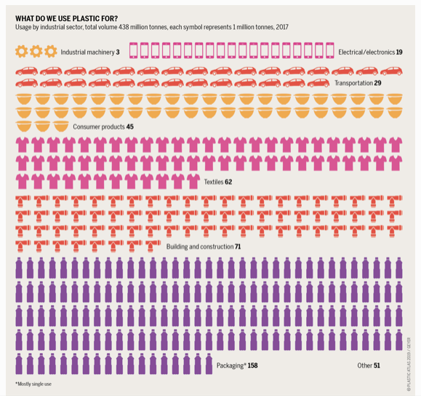
What do we use plastic for

Slide 6
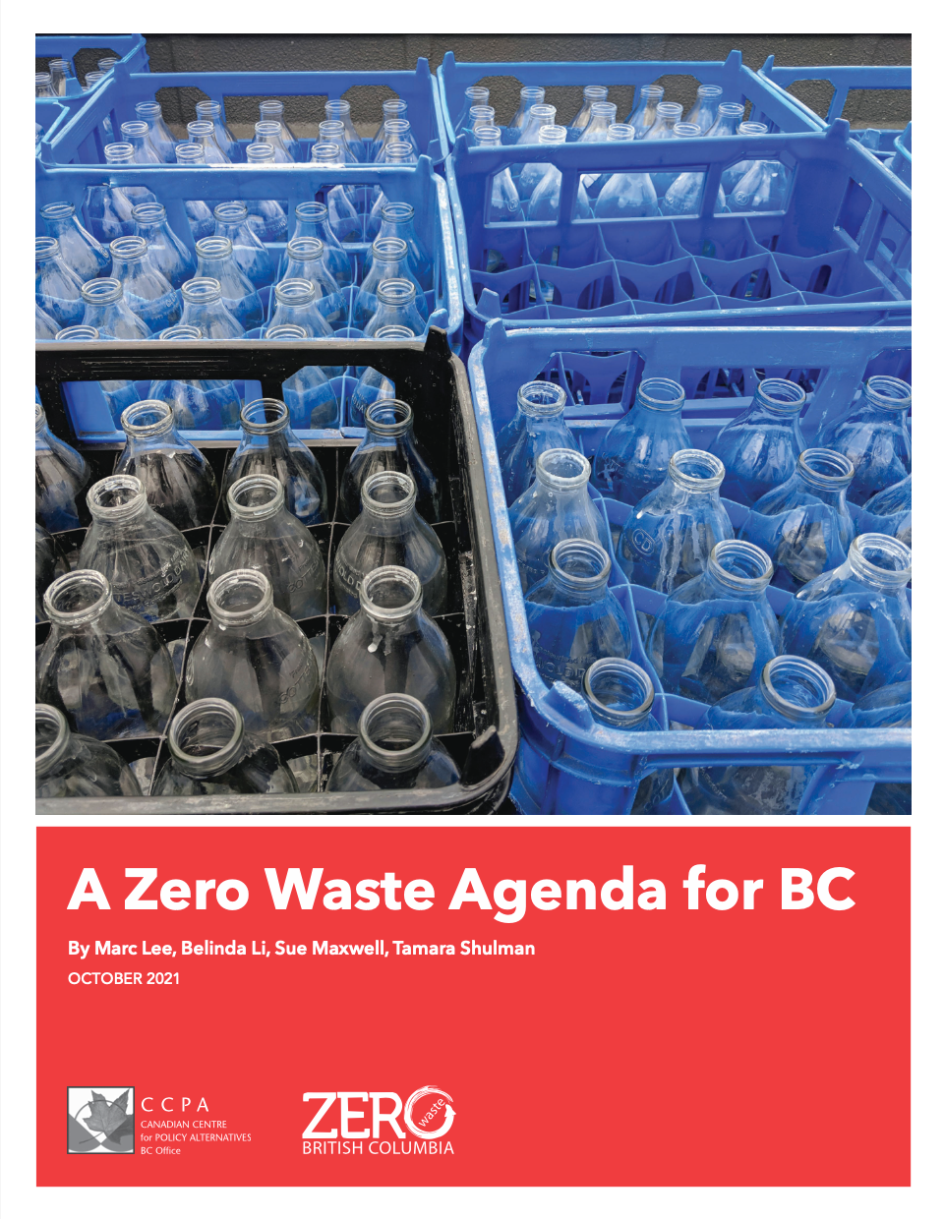


Slide 7
Extended Producer Responsibility (EPR)
BC Recycling Regulation covers hazardous materials, electronic/electrical, beverage containers (deposit), tires, and residential packaging and paper
Mattresses, EV batteries and more hazardous materials to come
Missing ICI packaging and paper, C&D, textiles and others
Meant to follow pollution prevention hierarchy but focus has been recycling and collection
Gaps in services –especially smaller communities
Doing the minimum?
Need to raise the bar
Notes:
(solvent, flammables, pharmaceuticals, pesticides, gasoline, oil, paint, lead acid, antifreeze)

Slide 8
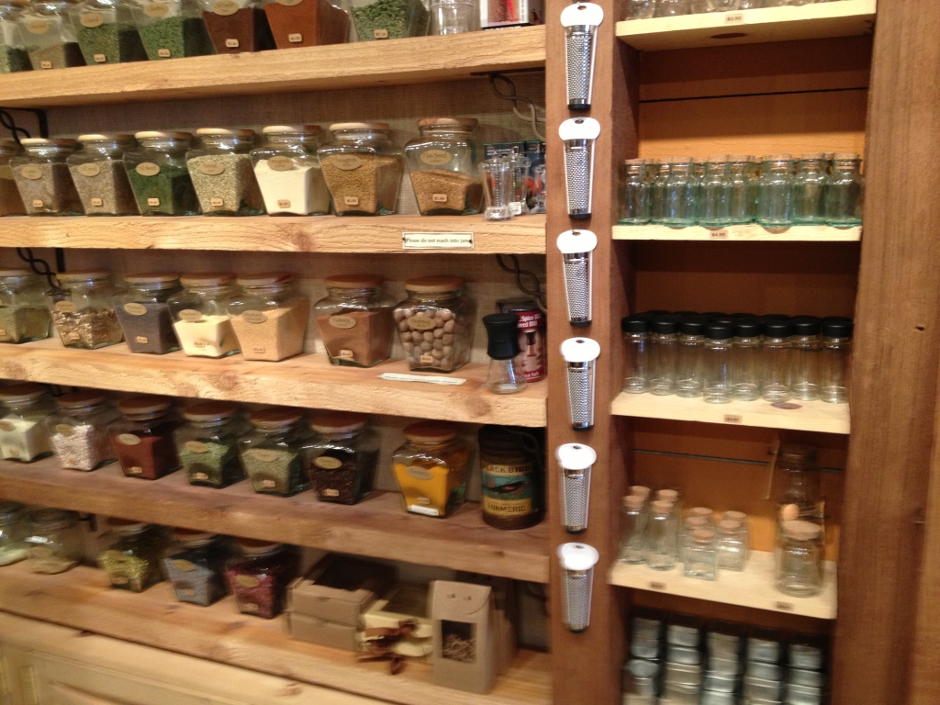
Beyond Recycling -recommendations
Innovation agenda for sharing, reuse, refill and repair
Extended warranties
Right to Repair
Notes:
Refilling –beer bottles, some milk, some refill stores
88,100 tonnes of reuse in Metro Van in 2018

Slide 9
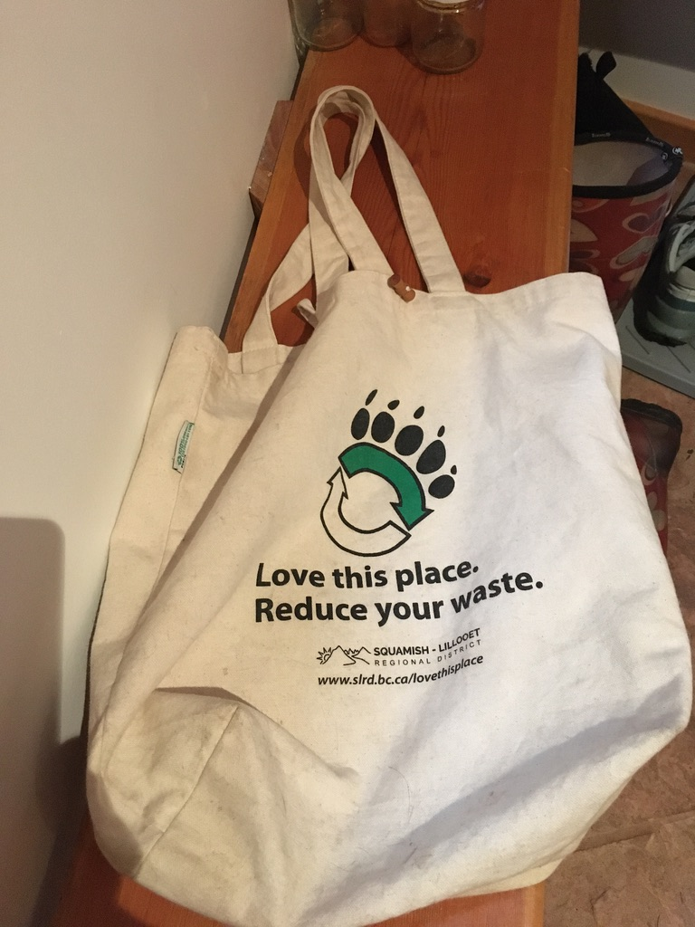
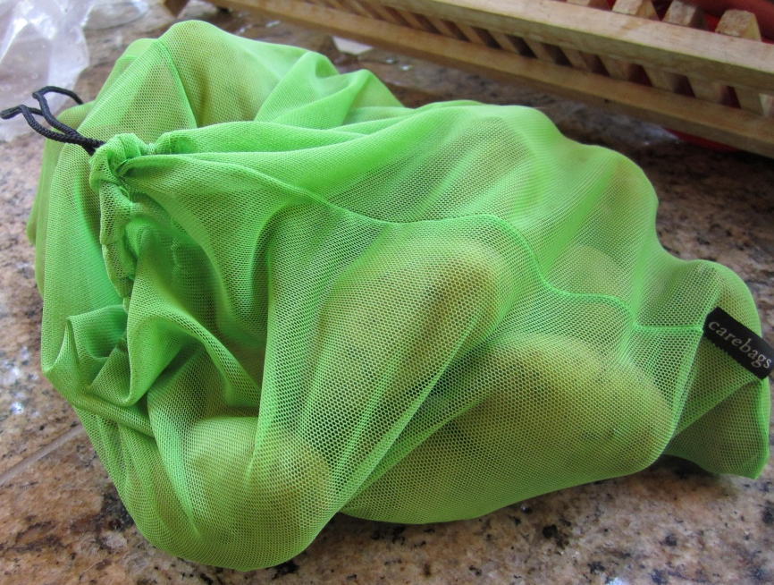
Plastics –addressing a growing problem
Ban single use plastics
Cap and tax virgin plastics
Streamline types
Stimulate small and medium sized businesses to reuse, recycle or replace

Slide 10
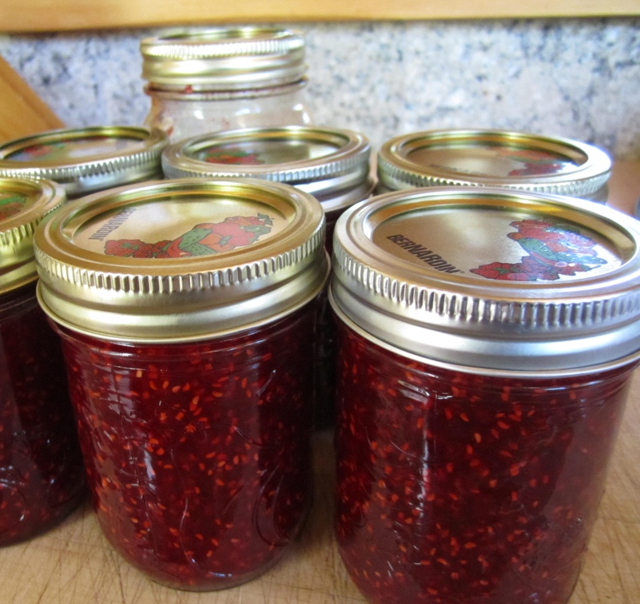
Organics
Increased collection
BC target of disposal restrictions covering 75% population met
33% ↓ in garbage when weekly green bin and every other week garbage collection established in Metro Vancouver jurisdictions
Government infrastructure funds
Need food waste and organics capture targets, education, enforcement, infrastructure, end markets

Slide 11
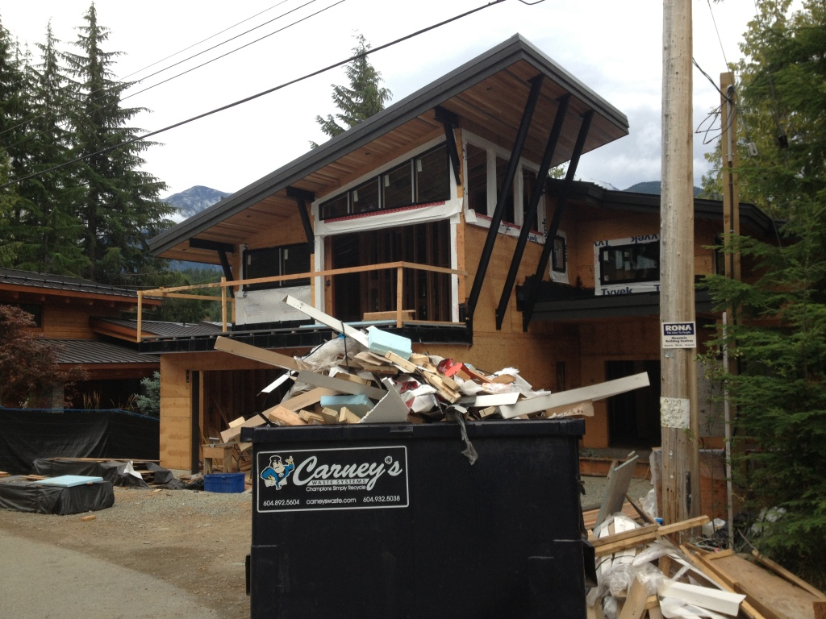
Construction & Demolition Deconstruction
Set provincial targets
Mandate overview, monitoring, reporting of all facilities
Develop comprehensive policy and regulatory framework
Use public procurement
Infrastructure for hubs and processing

Slide 12
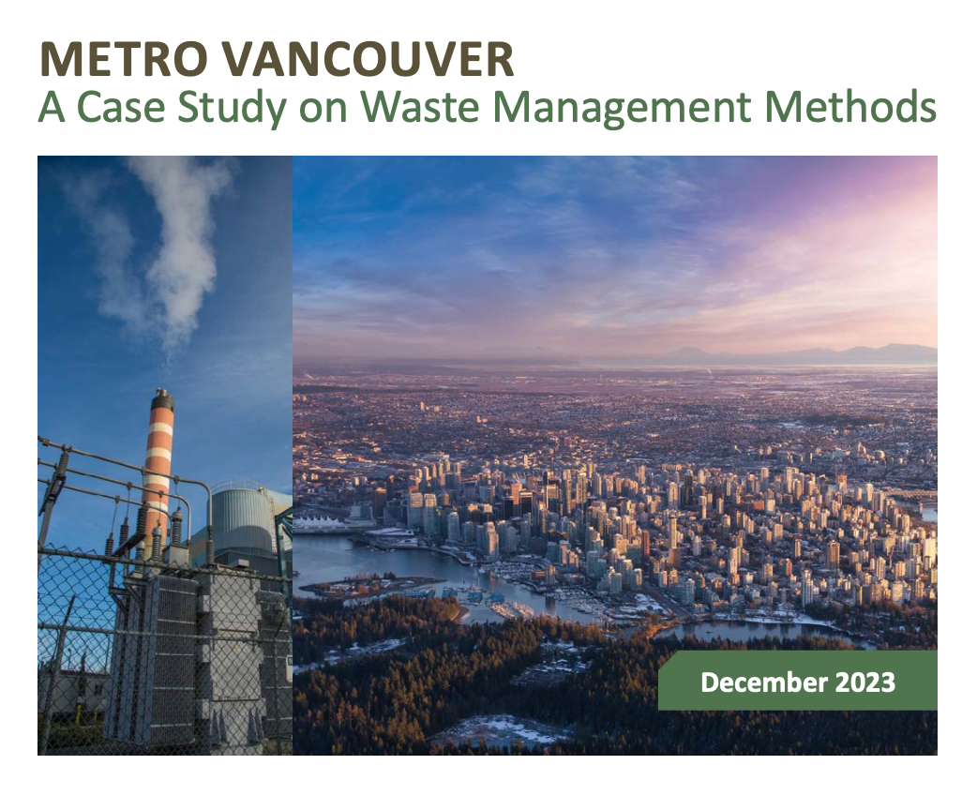
Benefits from Closing the Incinerator
Reduce GHGs
Reduce costs
Less pollution (including no dioxins)
Improve air quality
Decreased public and environmental health risks
Focus on waste reduction
Report: https://www.zerowastebc.ca/about-us/our-work/#Research
Notes:
+ letter to MV on Operating Certificate

Slide 13
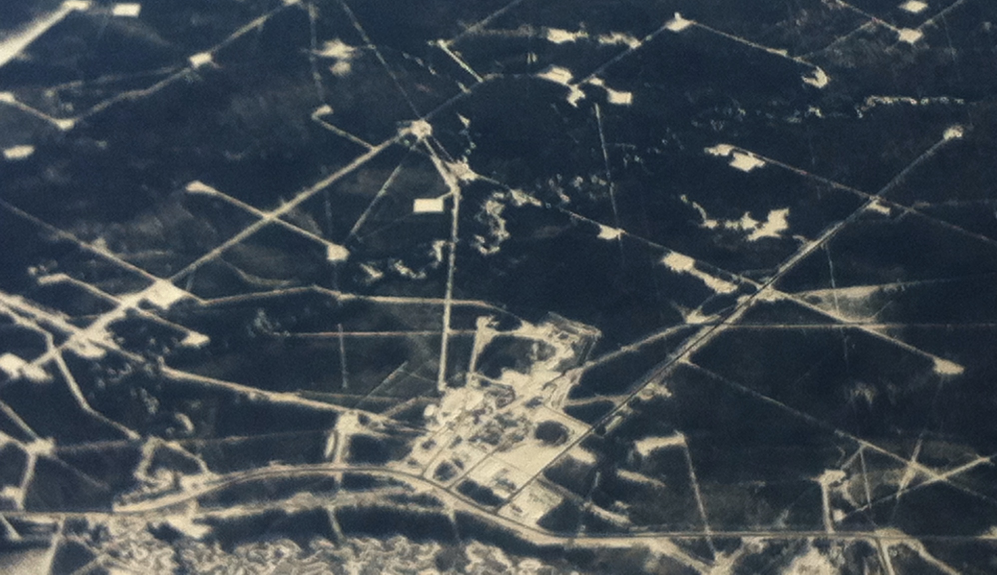
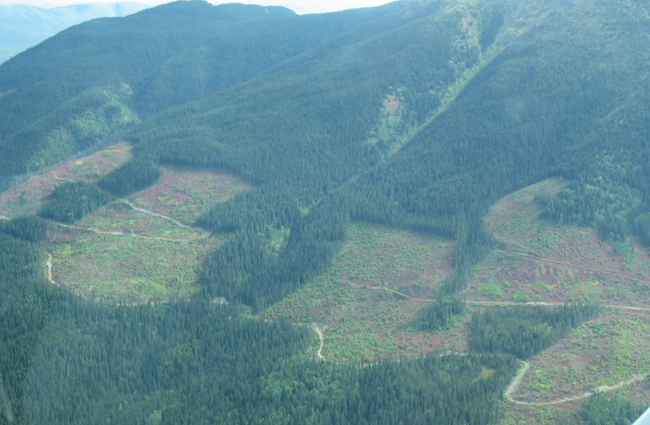
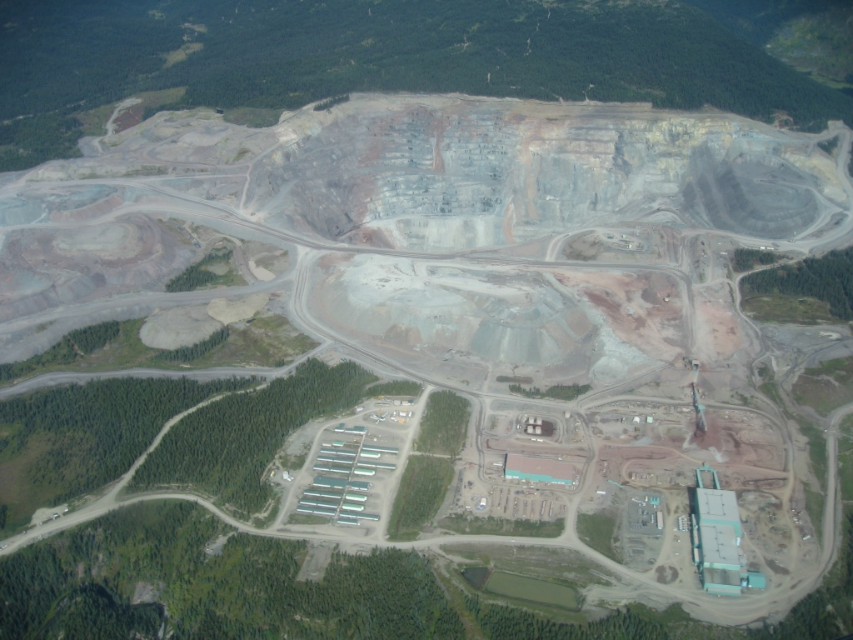
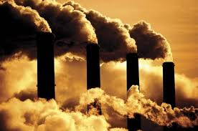
Other benefits of ZW/CE
Jobs
  more as you move up the hierarchy
  need labour training and protections
Climate change
  emissions from disposal dwarfed by emissions from consumption
  could reduce GHGs by 7.1 M tonnes by 2040 with Zero Waste
Ecosystem Impacts

Slide 14
What should we do regarding plastics to move towards a Circular Economy in BC & Canada?
Question

Slide 15
Speakers
Clair Lloyd – BC Ministry of Environment and Parks
Ruth Abbe – Zero Waste USA
Nicolas Demers – Recycl-Québec
Baptiste Roubaud - CITEO

Slide 16
Questions
Suggestions
slido
Google Doc

