Slide 1
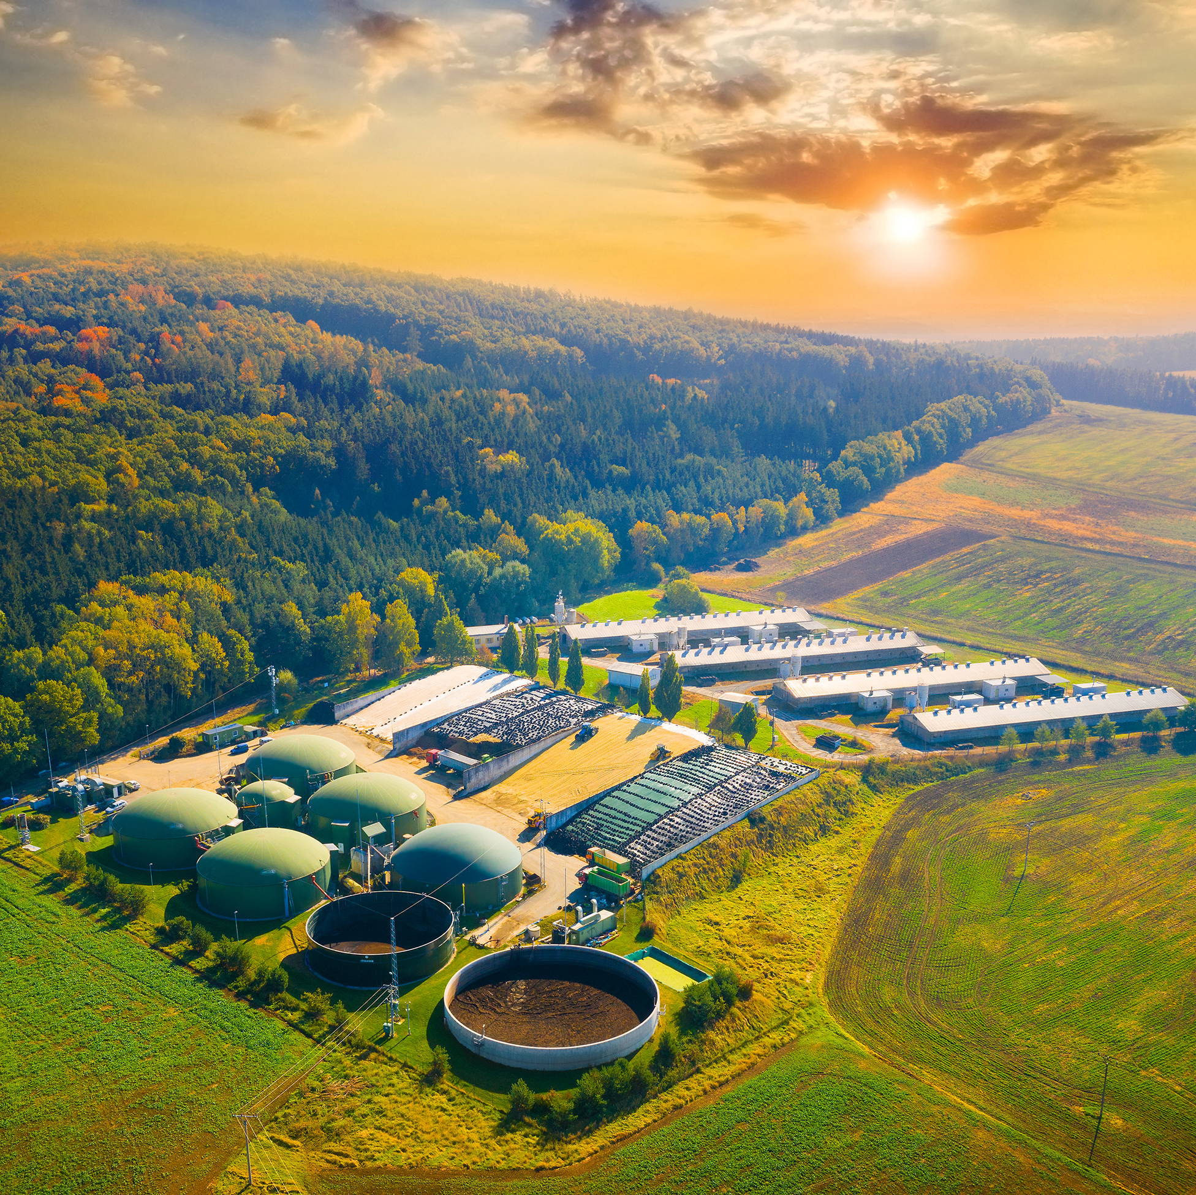
Extended Producer Responsibility and Circular Economy in Québec
April 9th, 2026
Plastics Waste Forum: The Next Steps Forward
Nicolas Demers
Environmental Advisor, EPR and Support Programs
RECYC-QUÉBEC

Slide 2
Content Plan
Overview – RECYC-QUÉBEC
  Roles and responsibilities
Timeline and application of EPR in Québec
  Stakeholders
  Targeted Products and Active programs
  Key Obligations
Circular Economy
  Intersection of EPR and Circular Economy in Plastic Waste policy
  Recent Developments in the Québec Circular Economy Framework
Challenges and Opportunities
Next Steps

Slide 3


Roles and Responsibilities
Mission: Encourage Quebec to reduce, reuse, recycle and recover residual materials from a circular economy perspective to fight against climate change.
Specific relevant responsibilities:
- Recognition, monitoring and reporting of PROs and individual programs under EPR
- Promote circular economy practices with research, counseling or financial programs

Slide 4
Stakeholders
Businesses subject to the EPR Regulations
Trademark owners or users with an establishment in Québec (manufacturers, producers, retailers, depending on the supply chain) First suppliers or marketers in Québec, if the manufacturer is not in Québec Businesses outside Québec and transactional websites, in certain cases (see the Regulation)
Management organizations and programs recognized by RECYC-QUÉBEC in 2026
10 Producer Responsibility Organizations (PROs), 2 Designated Management Bodies (DMBs) and a handful of individual programs, enabling the thousands of subjected businesses to fulfill their obligations to recover and reclaim products in Québec.
Service providers of recognized programs
For each product category, recovery programs rely on the participation of a network of service providers for the collection, transportation, safe handling and reclamation of materials. These businesses may also be members of the programs if they are subject to the Regulations.

Slide 5
Stakeholders (continued)
The network of drop-off points
The 3 EPR Regulations require different types of recovery infrastructure, either through direct collection or via a minimum number of drop-off points on Quebec territory (by administrative region, MRC or other specific requirements), which must be free to access. (e.g., exclusive collection points, retail businesses, ecocentres, HHW drop-off points and public equipment, etc.)
The role of the citizen and private enterprise
EPR works on a user-payer basis – the consumer also finances the recovery system, since the producers will always pass on the cost (if permitted); but the system only works if the product is returned appropriately. For companies, conditions apply depending on the quantity or nature of the product.
Levels of government
The RRVPE is a provincial regulation under the Environment Quality Act. The MELCCFP is responsible for regulatory amendments and RECYC-QUÉBEC is responsible for monitoring the reporting. In addition to this collaboration, the municipal sector, which operates several drop-off points, is also an important player.

Slide 6


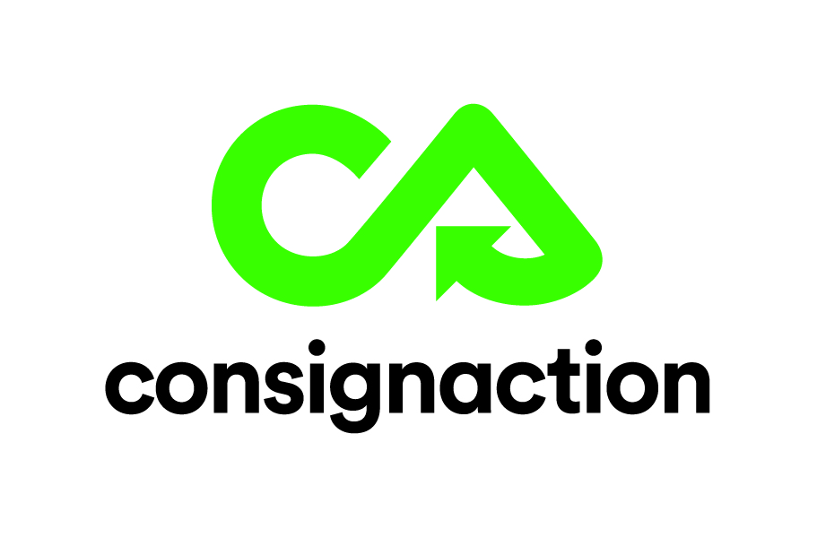









QUÉBEC EPR TIMELINE
2001
Regulations on the recovery and recycling of discarded paint containers and paints
2004
2011
Regulation respecting the recovery and reclamation of products by enterprises
Cells and batteries
Mercury lamps
2022
Modifications to the Regulation respecting the recovery and reclamation of products
Regulation respecting a system of selective collection of certain residual materials (Blue Box)
Regulation respecting the development (…) of a deposit-refund system for certain containers
Household and commercial appliances and air conditioners
2023
Agricultural products
Beverage containers -Deposit-refund system (Phase 1 - EPR transition, metal and specific beer glass bottles)
2024
Pressurized fuel containers
Pharmaceutical products
2025
Blue Box – Transition towards EPR (Phase 1)
Beverage containers - Deposit-refund system (Phase 2 – Plastic containers)
2027
Beverage containers - Deposit-refund system (Phase 3 – Glass containers)
Electronic products
Paints and containers
Oils, antifreeze, filters, coolants and their containers
Regulation respecting the recovery and reclamation of used oils, oil or fluid containers and used filters
Paints and containers
Oils, antifreeze, filters, coolants and their containers
Notes:
10 OGR / 2 OGD / 8 programmes individuels

Slide 7
Key Obligations
Achieve the mandatory minimum recovery rates
Set up a free recovery structure (drop-off points or collection)
Respect the hierarchy of the 3RVs in the choice of management methods
Promote local product management
Implement reuse criteria
Audit and enable traceability of recovered materials
Plan for the management of containers and packaging used to bring products to drop-off points as well as those used to transport them to processing centers
Produce information, awareness and education campaigns
Promote research and development in their sector
Report annually to RECYC-QUÉBEC
Publish program performance results annually

Slide 8
Intersection of EPR and Circular Economy in Plastic Waste Policy
Overview: Blue box and beverage refund system transitions towards EPR were opportunities to include products and materials not previously managed by older systems, many in the plastic sector, thus creating a framework to tackle their end of life.
Blue Box : EPR transition from government compensation program formally started on March 1st, 2025.
Targeted products: All PPP, residential or commercial, regardless of use
Container refund system: EPR transition from a regulated program (mostly beer) with new designation plastic beverage containers started March 1st 2025.
Targeted products: All types of beverage containers from 100ml to 2L.
Products containing a battery as a component – Vapes, toys, IOT devices etc
Plastic type | 2030 Mandatory recovery rate | 2030 Mandatory reclamation rate
Rigid plastics - (HDPE) type | 75%, increased by 5% every 5 years until 90% | 60 %
Rigid plastics - (PET) type | 75%, increased by 5% every 5 years until 90% | 60 %
Other rigid plastics | 45%, increased by 5% every 5 years until 85% | 35 %
Flexible plastics | 45%, increased by 5% every 5 years until 85% | 20 %

Slide 9
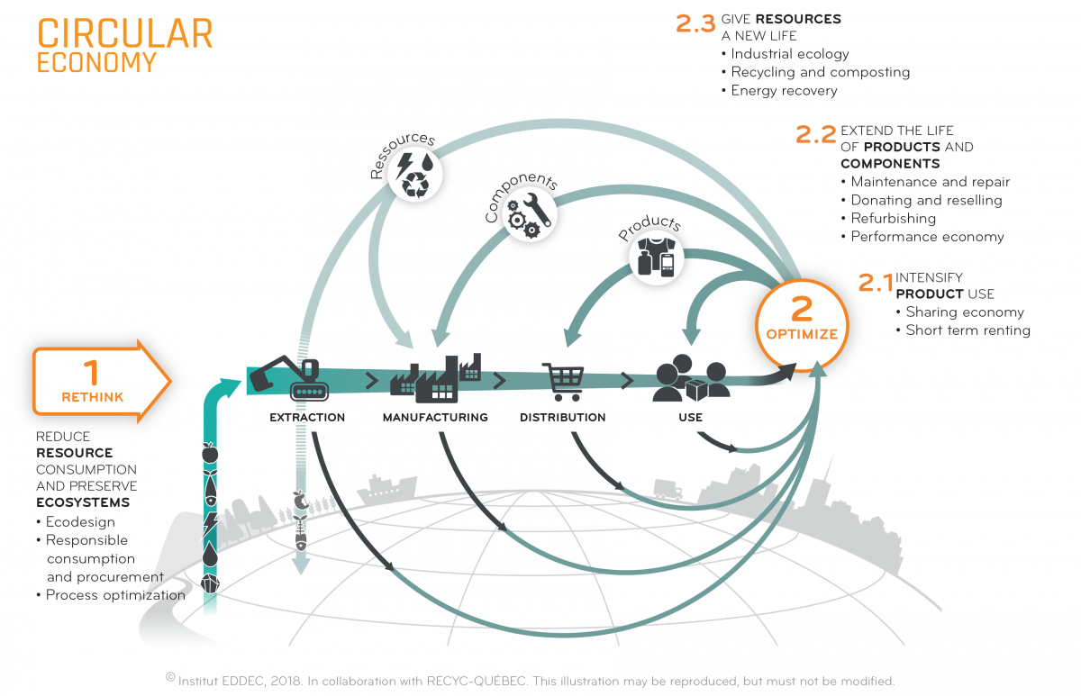
Notes:
Our own Circular economy diagram in Québec
Create in 2018 with various stakeholder.
12 different strategies, to rethink and optimise the use of resources

Slide 10
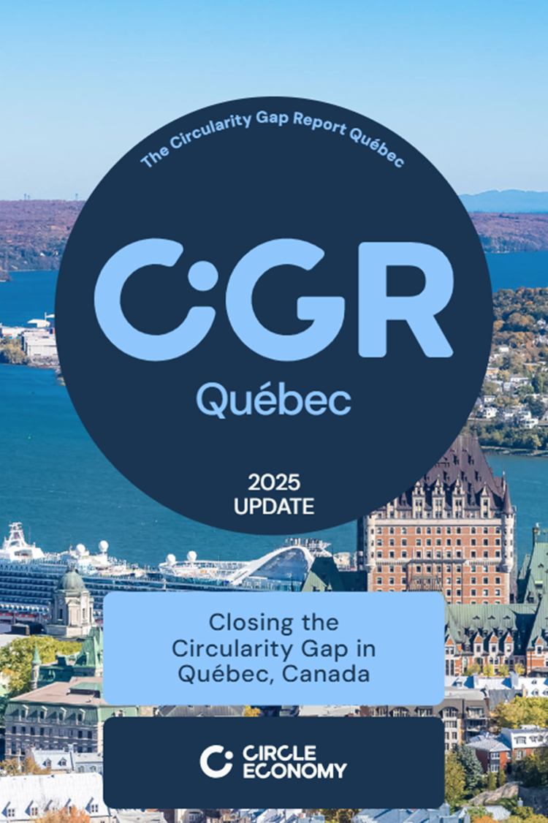

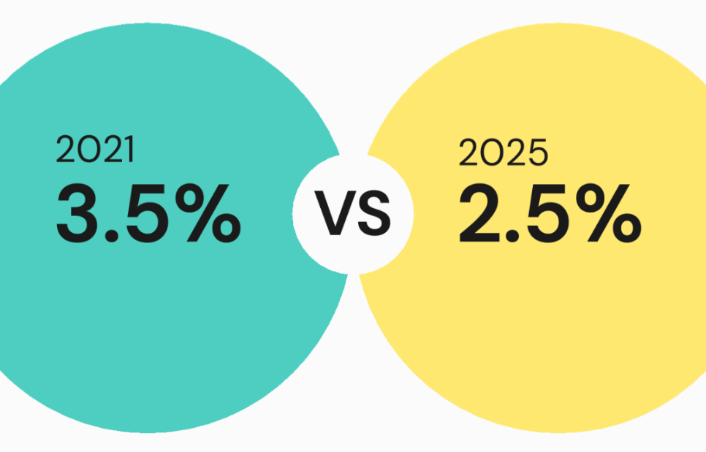
Circularity Gap Report Québec
,
,
Source image: Circle Economy
Notes:
Lors de la première prise de mesure en 2021, l’indice de circularité du Québec était de 3,5 %. À la suite du recalcul de l’indicateur à l’aide des dernières données disponibles, cet indice est maintenant de 2,5 %.
Cette baisse s’inscrit dans la tendance générale, l’indice de circularité mondial ayant également diminué de 9,1 % en 2018 à 6,9 % en 2025.
Les facteurs suivants peuvent expliquer le nouveau résultat au Québec :
L’augmentation générale de la consommation de ressources, un phénomène observé mondialement;
La prédominance actuelle de l’économie linéaire sur l’économie circulaire;
La vaste superficie de notre territoire et sa faible densité de population, qui amènent une pression à la hausse sur les infrastructures et constructions variées;
L’économie du Québec est 3.5% circulaire.
Ce qui veut dire que beaucoup des ressources utilisées pour répondre à nos besoins sont gaspillées , émis dans l’atmosphère ou encore stocké dans nos infrastructures pour de longues périodes…
Surpris? Pas tant que ça, on avait des comparables:
Le monde au total 8.6%
La Norvège: un autre pays nordique avec l’exploitation de leur ressources naturelles : 2.4%​
Austria: 9.7%​
Les pays-Bas: les champions à 24.5%​
Raffinement de la méthodologie de calcul qui permet de mieux capter les divers flux de matières qui composent l’indice.

Slide 11
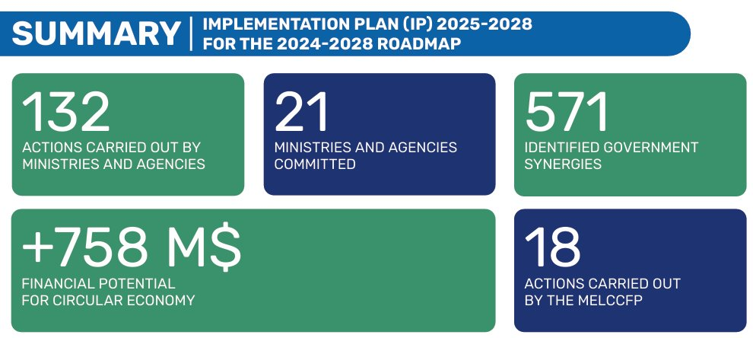
QUÉBEC GOVERNMENT CIRCULAR ECONOMY ROADMAP 2024-2028
Roadmap summary
11
Notes:
Notre indice de circularité est de 2,5 %. Le gouvernement du Québec veut l’augmenter à 5 % pour 2028.
La Stratégie gouvernementale de développement durable (SGDD) est le véhicule pour implanter le cadre de gouvernance et de coordination par le biais d’une feuille de route gouvernementale, réalisée en collaboration avec RECYC-QUÉBEC
La FREC priorise cinq secteurs économiques, 22 objectifs et 50 mesures, 132 actions par 21 MO dans le dernier PMO afin de contribuer à l'augmentation du taux de circularité et de productivité des matières du Québec.
Les mesures devront être en place au 31 mars 2028. Parmi les mesures proposées aux ministères et organismes figurent le développement et le soutien de la recherche et de l'innovation, la bonification du cadre législatif, politique et financier, la concertation entre les acteurs des différentes chaînes de valeur touchées, l'exemplarité de l'État et la poursuite de l'action du Québec à l'international.
Les interventions se feront de façon prioritaire dans les secteurs à haut potentiel de circularité : bioalimentaire, construction, manufacturier (textiles et produits électroniques ou électroménagers), mines et énergie.
L'élargissement de la liste des secteurs prioritaires au cours des prochaines années se fera de manière à répondre aux priorités économiques du Québec.
En ce qui concerne les travaux structurants de révision de la Politique québécoise de gestion des matières résiduelles, ceux-ci répondront, notamment, aux constats du rapport du Bureau d'audiences publiques sur l'environnement (BAPE) sur l'état des lieux et la gestion des résidus ultimes, ainsi qu'aux orientations gouvernementales en matière d'économie circulaire.
Consultation: 40 MO et 63 organisations externes (organismes à but non lucratif, établissements d’enseignement, milieu de la recherche, secteur privé et citoyens).

Slide 12

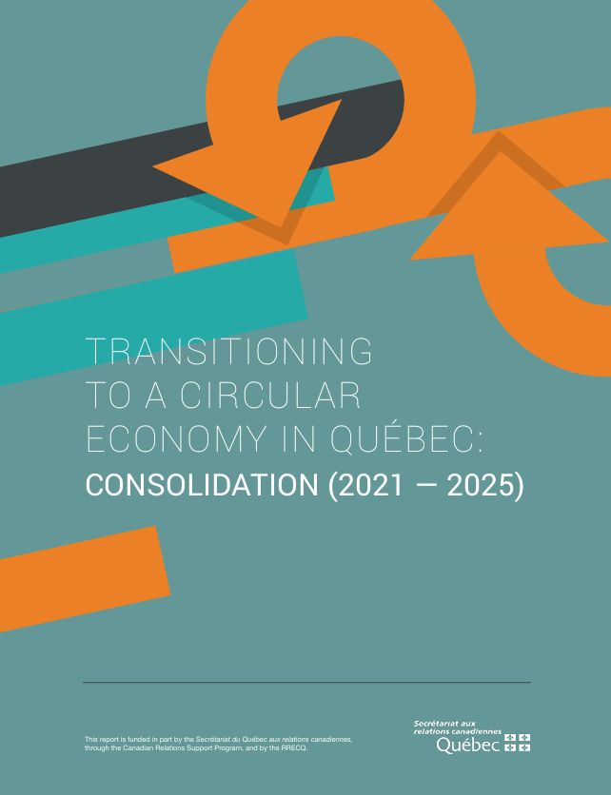
Everything you wanted to know about circular economy in Québec but were afraid to ask...
Quebeccirculaire.org
Notes:
Two interesting report to know everything in CE in Québec in the last 10 years... available in english!
For more info, see quebecirculaire.org website to have all the tools and news on the topic.

Slide 13

Challenges & Opportunities
Free riders: Obliged producer under EPR that does not contribute to an official program
Attracted by an unfair competitive advantage in the market, free riders reduce the official programs’ effectiveness by evading environmental management costs
Financing: Circular economy and EPR require shared sectorial investment
Difficulty setting up structures to implement new eco-design, reusability or alternative recycling processes, as these depend on R&D reliant on significant shared capital expenditure and additional technical resources that raise costs.

Slide 14
Next Steps
EPR Transition implementation for traditional plastic recycling systems and refund-deposit for beverage containers
Reducing cost of recovery and reclamation by fostering innovation and local markets outputs
Using circular economy practices to reduce consumption and optimize resource use throughout the supply chain

Slide 15

THANK
YOU
Contact :
Nicolas Demers, RECYC-QUÉBEC
n.demers@recyc-quebec.gouv.qc.ca
Web site
www.recyc-quebec.gouv.qc.ca

