Slide 1
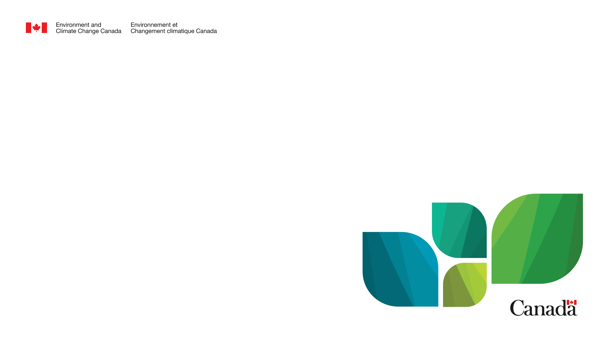
Update on Federal Agenda:
Advancing a Circular Plastics Economy for Canada
April 9, 2026
Zero Waste BC Plastic Waste Workshop
Matt LeBrun
Director, Plastics Regulatory Affairs Division
Environment and Climate Change Canada

Slide 2
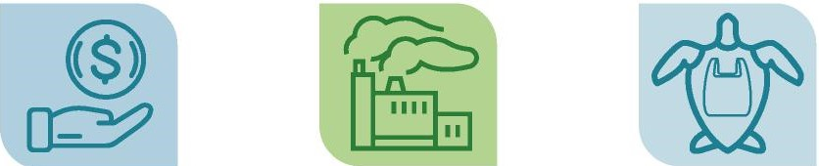
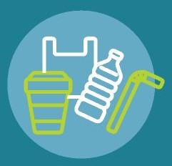
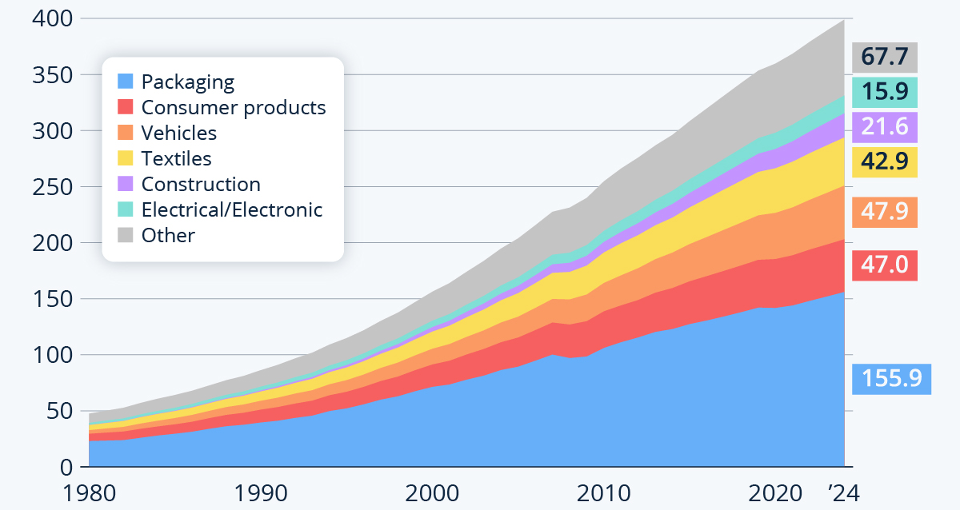
State of plastics globally
Global plastics production, 1980 to 2020 (tonnes)
Plastic pollution costs up to $2.5 trillion in ecological, economic and social impacts annually
Over
800 species worldwide are impacted by marine litter
Global plastic production and waste is set to triple by 2060
22% of plastic waste is mismanaged or released into the environment - by 2040, 23-37 million tons of plastic waste will enter the ocean every year
(equipment, furniture, etc.)
Data source: OECD (2022)
Plastic-related emissions could reach 1.34Gt/year equivalent to more than 295 new 500-MW coal-fired power plants by 2030
Countries around the world are currently developing an international legally binding instrument on plastic pollution
Notes:
Global action across the plastics lifecycle could nearly eliminate plastic pollution by 2040 | OECD

Slide 3


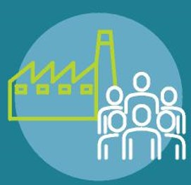
State of Plastics in Canada
Domestic Context
State of Plastics in Canada
Plastic Consumption, Waste Generation and Pollution trends in Canada 2019 - 2040
A threat…
40%
Plastic pollution is ubiquitous, persistent, harmful and comes from a wide range of sources, primarily attributed to the mismanagement of plastic waste. Plastic pollution is found across Canada in air, water, and land.
Almost 5 million tonnes of plastic waste annually – estimated economic loss of nearly $8B of landfilled plastic waste in 2016
29%
19%
baseline
projection
In thousand tonnes (kt)
Source: (EY, 2024)
1-2% of plastic waste enters the environment, impacting wildlife and livelihoods – $400M annual plastic pollution costs in the Great Lakes Region alone
But also an opportunity…
$35B sector with almost 100,000 workers, and a $540M recycling industry
In 2019, an estimated 90,000t of plastic materials were leaked into the environment from three key sources: mismanaged solid waste (54%), litter and not recovered waste (34%), and stormwater (12%).

Slide 4
Domestic Context
PROBLEM: Canada's complex plastics economy is mostly linear (i.e., "take-make-waste") with a series of key factors that prevent circularity
Costs of plastic pollution borne by individuals and communities
Municipalities, civil society organizations and volunteers left to deal with plastic pollution, citizens live with negative impacts
Virgin and recycled plastic markets compete
Primary resin production has high upstream GHGs and historic subsidies and economies of scale
Recycling has a more labour-intensive cost structure but can produce lower embodied carbon resins
Weak collection and end-markets for recycled plastics
Only 26% of all plastic waste and scrap is sent for material recovery
Just over 7% is recycled
Most plastic isn't designed to be recycled
Inconsistent supply of quality feedstock at competitive prices = unviable and lasting end-markets
Need to scale recovery options
Limited high-volume recovery options
Landfills remain a low-cost disposal alternative
Recycling receives most attention, but insufficient
Upstream innovations in product design, recyclability, and reuse business models are also necessary

Slide 5

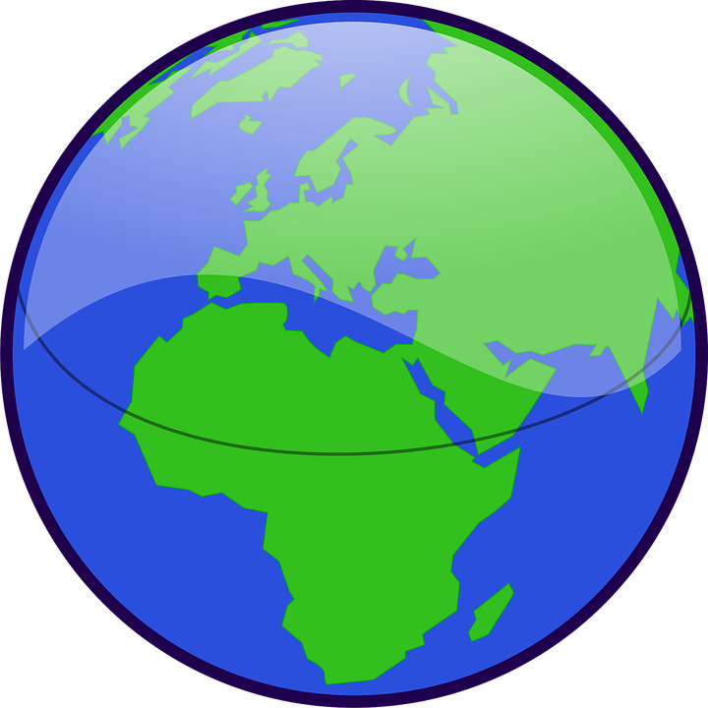
A Collaborative Effort: Shared Jurisdiction
Everyone has a role: Collective action for systems change and greater circularity
Municipal Governments
  Collect, divert & dispose of municipal solid waste, including organic waste
  Own landfills, and implement waste diversion by-laws and waste reduction and education initiatives
  Implementing a range of plastics policies (e.g., bans, promoting reuse)
Provincial and Territorial Governments
  Control intra-jurisdictional movement of hazardous waste
  Approve, license, and monitor waste management facilities
  Implement waste regulations, policies & programs (e.g., Extended Producer Responsibility – EPR; Institutional, Commercial and Industrial Waste; Waste Reduction and Diversion)
Federal Government
  Prevents and manages pollution, promotes clean growth, protects the environment and human health
  Works with PTs through Canadian Council of Ministers of the Environment (CCME)
  International agreements and negotiations
  Data and science, sector strategies, supporting innovation, R&D, infrastructure funding, procurement, fishing gear
International
  Global plastics treaty will commit Canada to concrete actions
  Kunming-Montreal Global Biodiversity Framework target 7 seeks to prevent, reduce and work towards eliminating plastic pollution
  Agreement on Biodiversity Beyond National Jurisdiction recognizes need to address plastic pollution to protect ocean ecosystems

Slide 6
Federal measures that tackle plastic pollution and waste
Federal Provincial/Territorial Collaboration
Working together through the Canadian Council of Ministers of the Environment to implement the Canada-wide Strategy on Zero Plastic Waste and Action Plan
Labels and Terms: published Guidance on the Use of Labels and Terms for Plastic Products and Packaging (2025)
Recyclability Guidelines: published Reference Compendium of Recyclability Guidelines for Plastic Products and Packaging (2025)
EPR: published Guidance to Facilitate Consistent Extended Producer Responsibility Policies and Programs for Plastics (2022)
Single-use and Disposable plastics: published A Roadmap to Strengthen the Management of Single-use and Disposable Plastics (2022)
Sector Based Roadmaps & Projects
Advancing efforts to reduce plastic waste and pollution in the textiles and electronics sectors:
  Textiles: published a consultation document (2024) and What We Heard Report (2025)
  Electronics: published a study (2019) and Proposed Roadmap (2024)
Committing $26.8 million across 18 Canadian Plastics Innovation Challenges to support small and medium businesses in developing Canadian-made solutions to reduce plastic waste and pollution
Advancing Science
Implementing Canada’s Plastics Science Agenda, conducting and investing in research along the entire life cycle of plastics, including the potential impacts of plastic pollution on environmental and human health
Investing $12M grants to enhance Canada’s scientific capacity in plastics science (including microplastics), and engagement with domestic and international experts
Global Leadership
Strong Canadian leadership and engagement in the Intergovernmental Negotiating Committee (INC) Process, including hosting INC-4, founding the Host Country Alliance (HCA), and being an inaugural and active member of the High Ambition Coalition (HAC)
Advancing science, policy and actions in multiple fora: G7, G20, United Nations Environment Assembly, Arctic Council, Commission for Environmental Cooperation, Global Ghost Gear Initiative

Slide 7
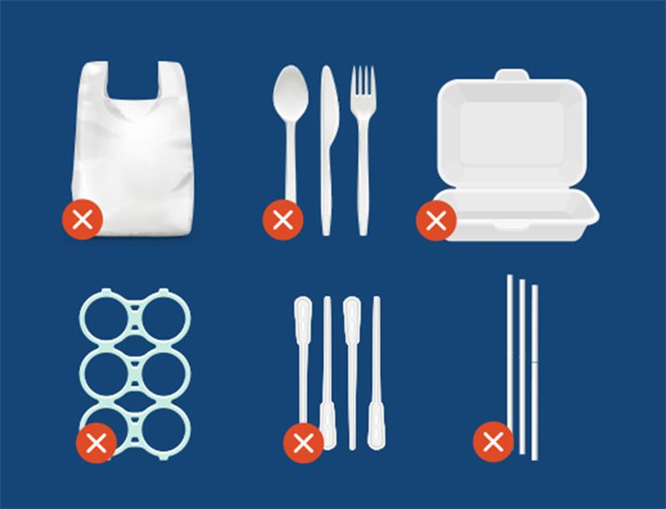
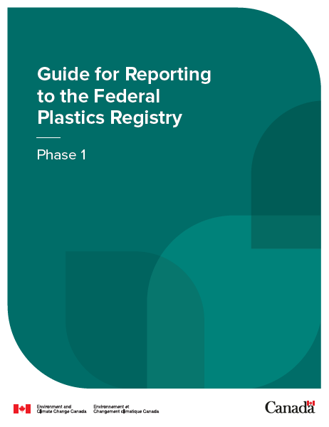
Federal measures that tackle plastic pollution and waste
  “Plastic manufactured items” (PMI) added to List of Toxic Substances on Schedule 1 of the Canadian Environmental Protection Act, 1999 (CEPA) based on science showing the harms of plastic pollution (2021)
    Federal Court of Appeal decision on January 30, 2026, upholds the PMI listing on Schedule 1 of CEPA
  Single-use Plastics Prohibition Regulations (SUPPR) prohibit the manufacture, import and sale of checkout bags, cutlery, certain foodservice ware, ring carriers, stir sticks, and straws (with exceptions) (2022)
    Microbeads in Toiletries Regulations (2017) – prohibit the manufacture/import/sale of toiletries containing plastic microbeads
    Federal Plastics Registry (2024) collects data from companies across the plastics value chain to track plastic from production to end of life

Slide 8
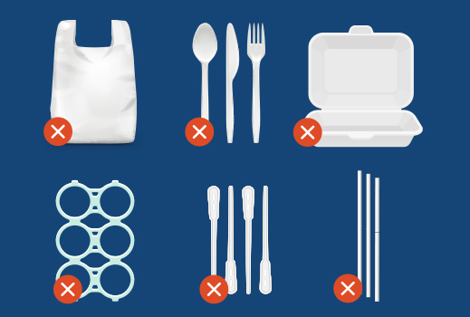
Single-use Plastics Prohibition Regulations
The Single-use Plastics Prohibition Regulations, published in June 2022, are part of the Government of Canada’s comprehensive plan to reduce plastic pollution.
Purpose
To prevent plastic pollution by eliminating or restricting six categories of single-use plastics that pose a threat to the environment, are difficult to recycle and have alternatives
Target
The Regulations prohibit the manufacture, import and sale of single-use plastic checkout bags, cutlery, foodservice ware made from or containing problematic plastics, ring carriers, stir sticks, and straws, with some exceptions for single-use plastic flexible straws
Impact
From 2023 to 2032, it is estimated that the Regulations will avoid 769 million garbage bags (1.3 Mts) of plastic waste and 13 million garbage bags (22 kts) of plastic pollution as well as avoid over $600 million in clean-up and pollution costs projected by 2032.

Slide 9
Single-use Plastics Prohibition Regulations
Recent developments
Proposed amendments to the Regulations to allow the export of the six categories of single-use plastics were published in the Canada Gazette, Part I on December 20, 2025, for a 70-day consultation period, which ended on February 28, 2026.
Considerations
Would prevent loss of Canadian manufacturing jobs and preserve important facility investments made by Canadian companies, while ensuring the Regulations continue to effectively protect the environment from the harms of plastic pollution
Aligns Canada’s approach with major trading partners, such as the European Union, who also have single-use plastics bans in effect
Next steps
Aiming to finalize amendments in 2026 after considering received comments

Slide 10
Federal Plastics Registry
Federal tool to gather data from across the plastics value chain to monitor and track the lifecycle of plastics
Addresses need to develop and maintain Canada-wide data on plastic moving through the economy
Covers data gaps not captured through EPR (e.g., inclusion of more types of packaging, more information on what plastic is making it into waste streams)
Reporting requirements update:
In response to stakeholder feedback, Phase 2 and 3 reporting requirements have been delayed.
Changes under consideration for the next notice:
Changes to the de minimis to better reduce burden on small entities
Refining definitions and product categories to address unclear language
Removing or reducing granularity for some of the reporting requirements or specific sectors
Stakeholder engagement:
Virtual workshops will be held later this spring to gather feedback on the next notice
Invitees will include industry, academia, and environmental non-governmental organizations

Slide 11
Recycled Content Policy in Canada
Recycled content workshop
On February 9, 2026, ECCC convened a workshop with 42 stakeholders across the plastics value chain, as a first step in its engagement on a path forward for federal recycled content policies.
Context
Recycled content is gaining momentum globally as a way to close the loop on plastics recycling, drive investments in recycling systems, and incentivize changes to product design
Recycled content commitments in CCME Canada-wide Strategy and Action Plan on Zero Plastic Waste (2019)
ECCC regulatory framework paper for RC & labelling published April 2023.
Industry advancing commitments through corporate plans and the Canada Plastics Pact.
Next steps
Workshop participants expressed broad support for federal mandates and other government measures (e.g. incentives) to strengthen recycled content demand for plastic collected through EPR.
ECCC will continue to consult with partners and stakeholders as it determines any actions on recycled content, with consideration to costs, benefits, and affordability.

Slide 12
Learn more about Canada’s Zero Plastic Waste efforts:
www.Canada.ca/zero-plastic-waste
1
2
7

