Slide 1
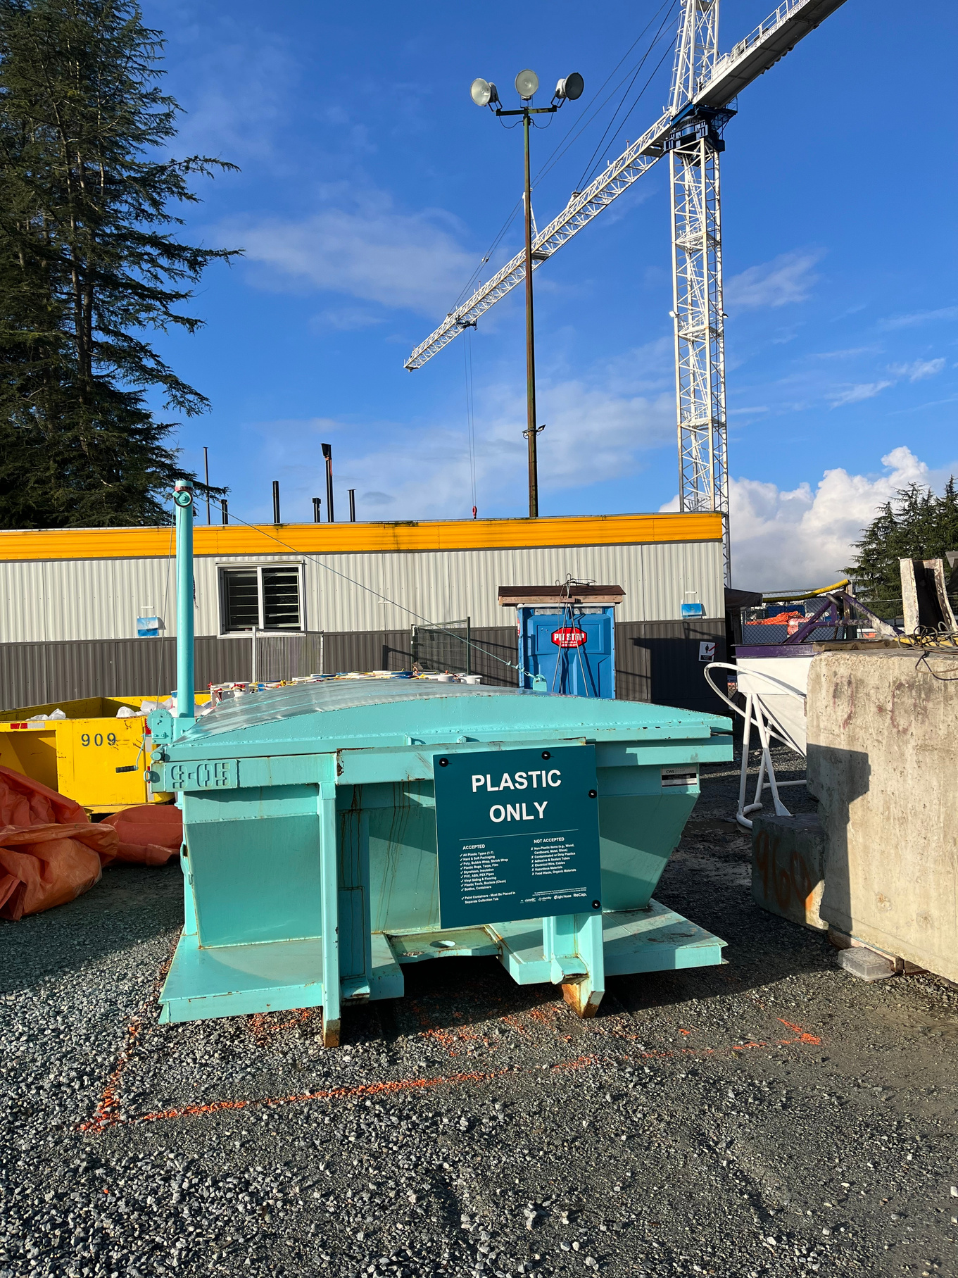


CONSTRUCTION
PLASTICS
INITIATIVE
A pilot program to repurpose plastic waste from construction sites in Metro Vancouver
POWERED BY

Slide 2











PROGRAM PARTNERS
PROGRAM
FUNDERS
PROGRAM PARTICIPANTS
2

Slide 3
THE CHALLENGE
In Canada, approximately 4.7 million tonnes of plastic is introduced annually to the domestic market.
3

Slide 4
THE CHALLENGE
Plastics in construction have received virtually no attention despite comprising approximately 30% of all plastic waste generated and 6%-9% of all CRD waste.
4

Slide 5
THE CHALLENGE
Currently, virtually all plastic generated on construction sites in Canada goes to waste-to-energy, landfill or is buried on site.
5

Slide 6
THE CHALLENGE
Environment and Climate Change Canada estimates that unrecovered plastics represented a lost economic opportunity of $7.8 billion annually.
6

Slide 7
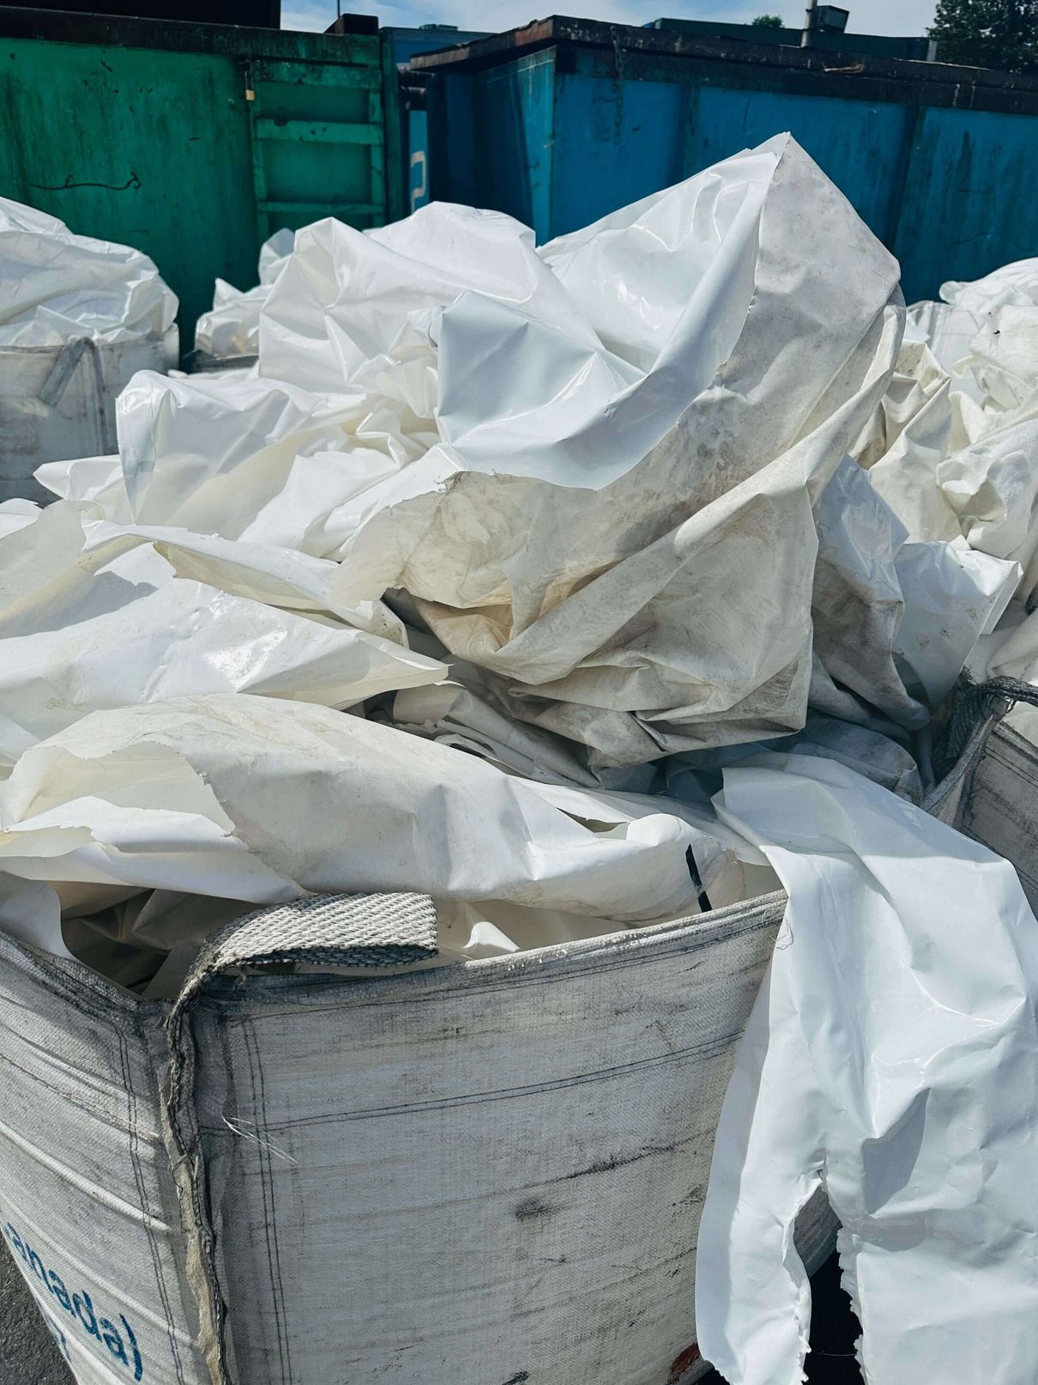
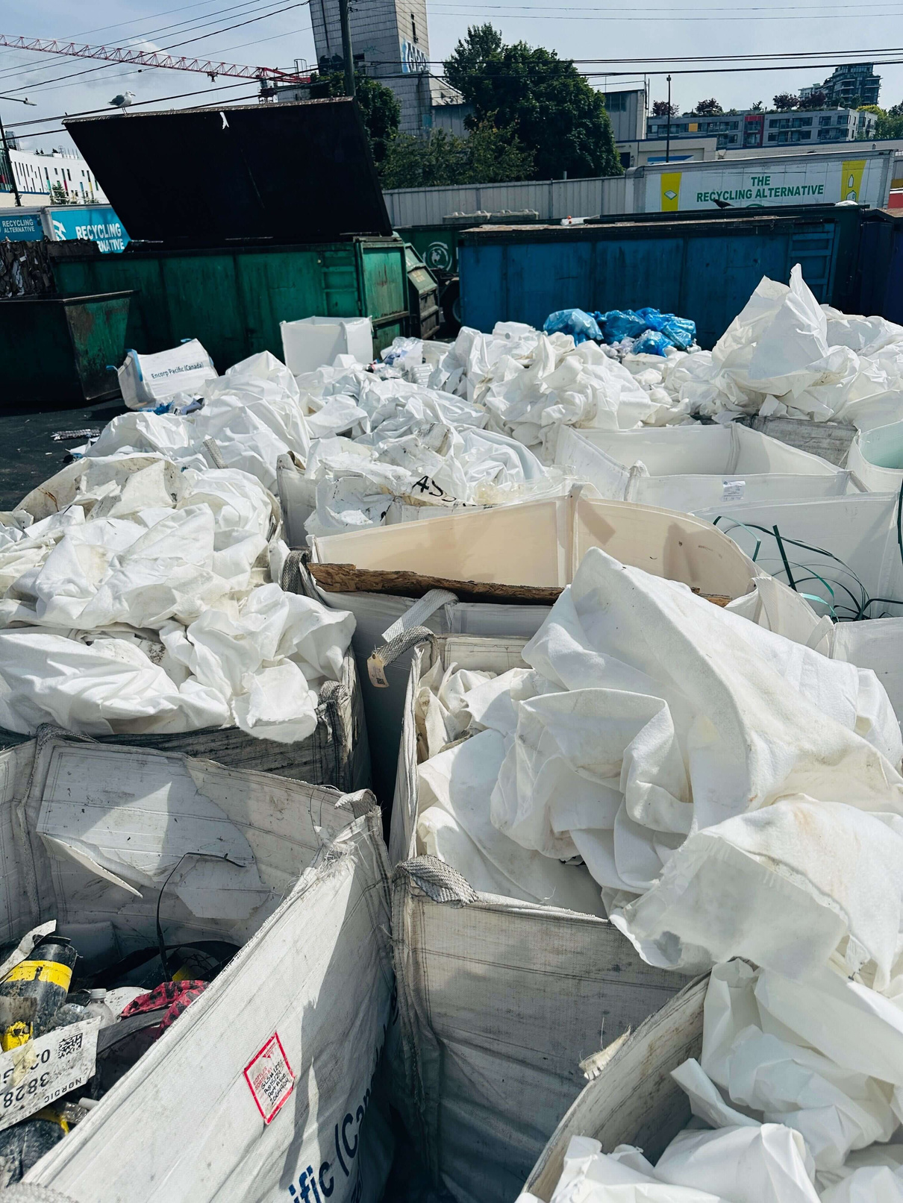

Slide 8
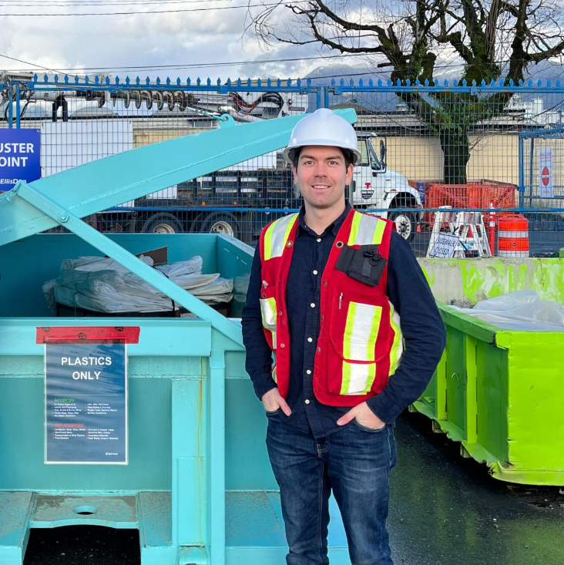
CONSTRUCTION PLASTICS INITIATIVE
PURPOSE
Demonstrate the feasibility of circular economic solution for plastics generated from construction and renovation activities.
8

Slide 9
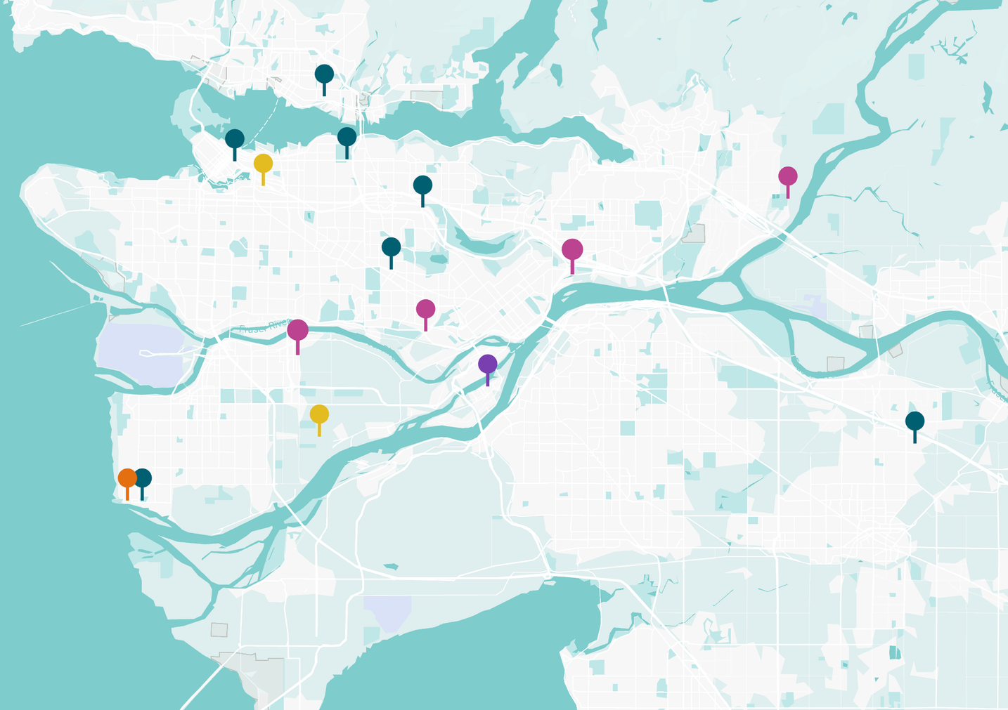





PARTICIPATING SITES
C
E,F
A
8 sites participated
4 institutional
3 commercial
1 infrastructure
Varying timelines between Jan-Dec 2025 depending on project stage
H
G
D
B
Legend Construction site
Hauler depot
Sorting facility
Processing facility
Manufacturing facility

Slide 10
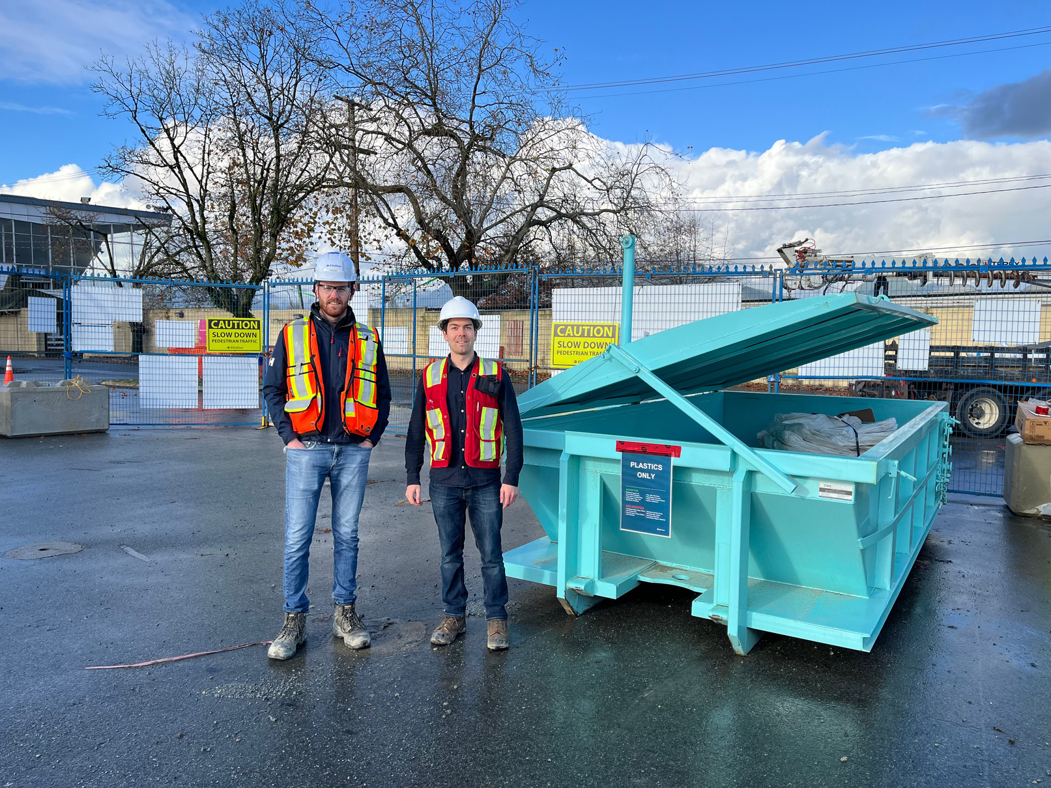
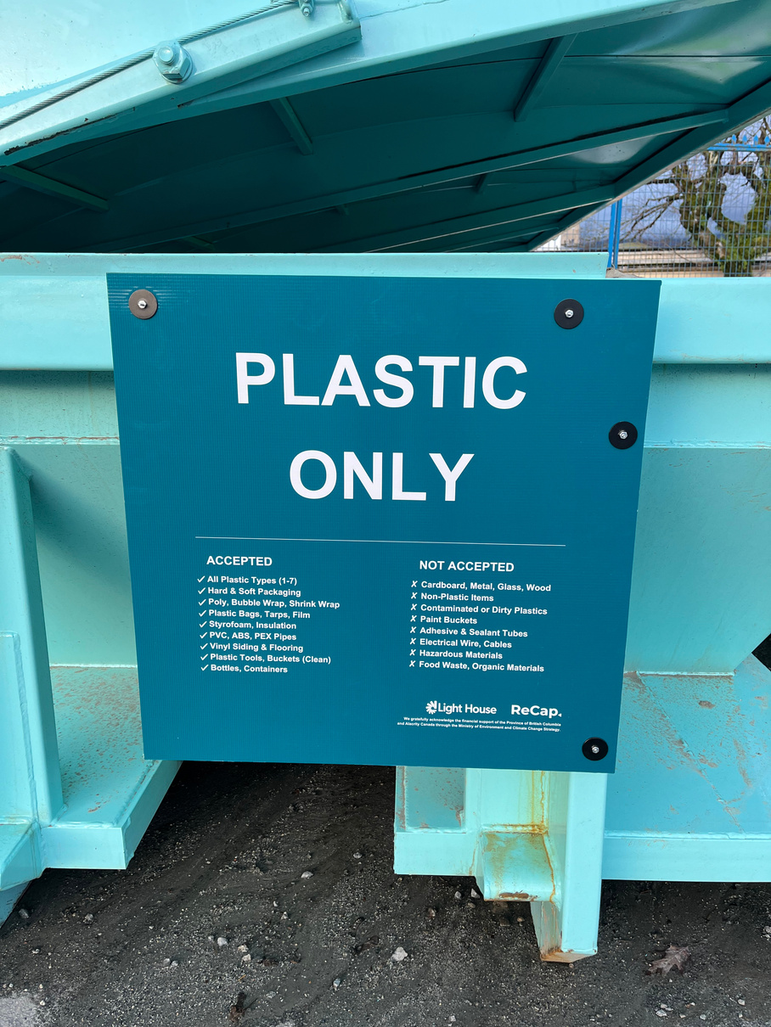
THE CPI PROCESS
Sites were provided with dedicated 20-yard bins and signage.
Separate totes were provided for plastic paint containers through EPR program (Product Care Association of Canada)

Slide 11
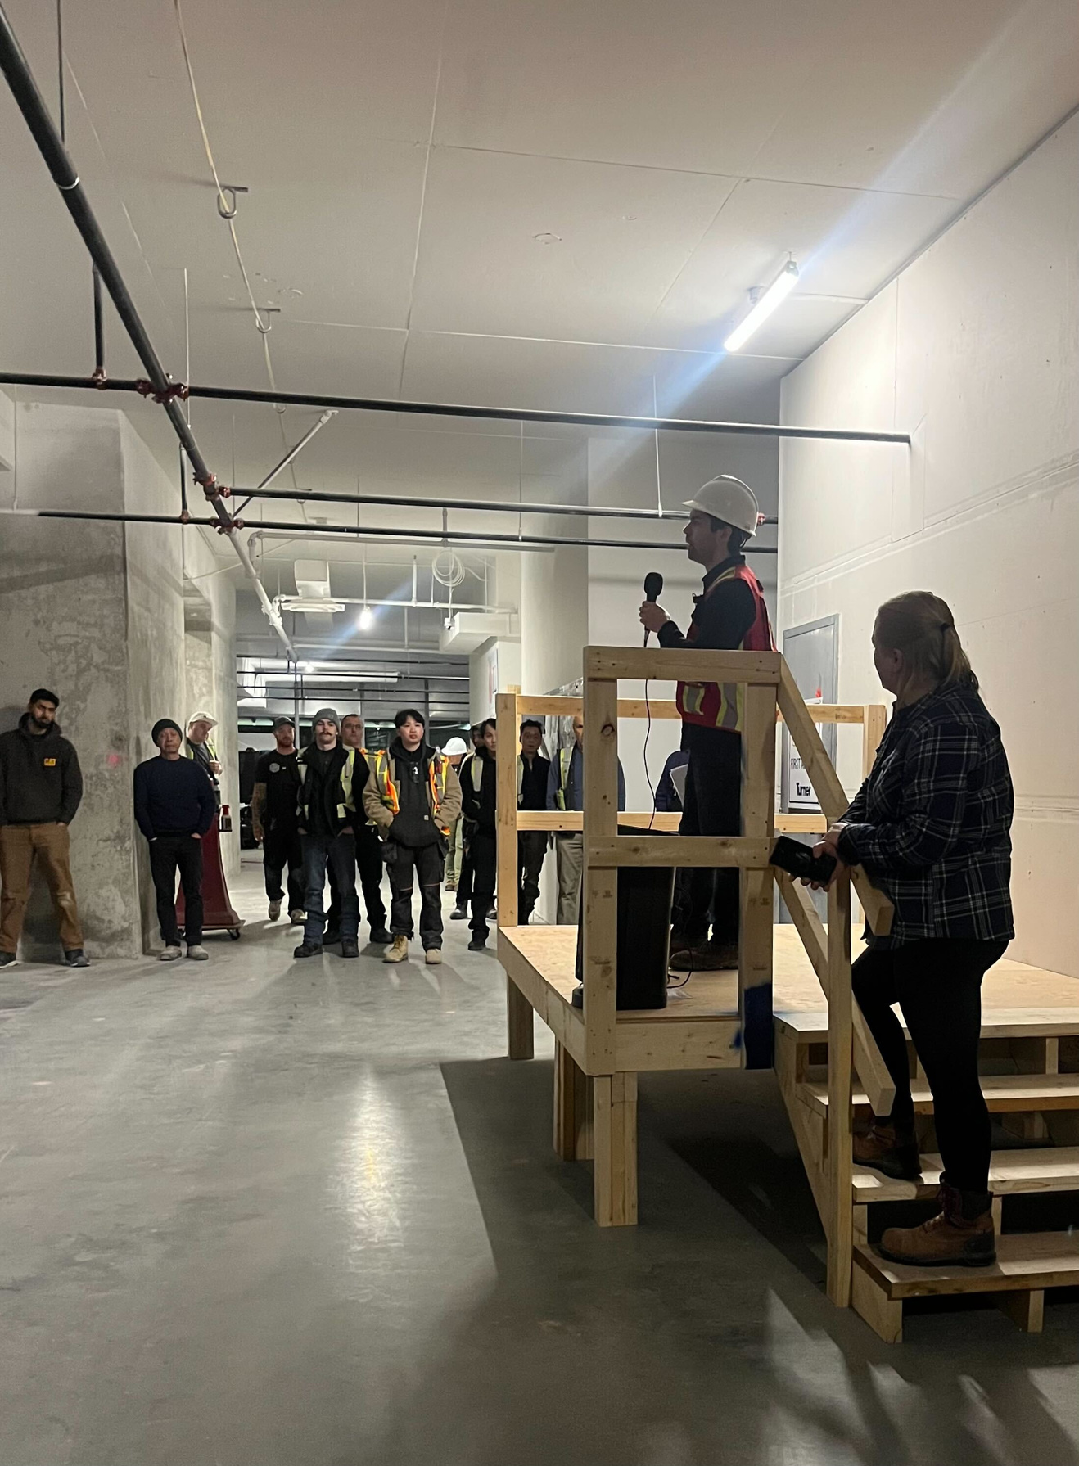
THE CPI PROCESS
Crews were trained
Sorting guides provided in four languages – all plastics accepted

Slide 12
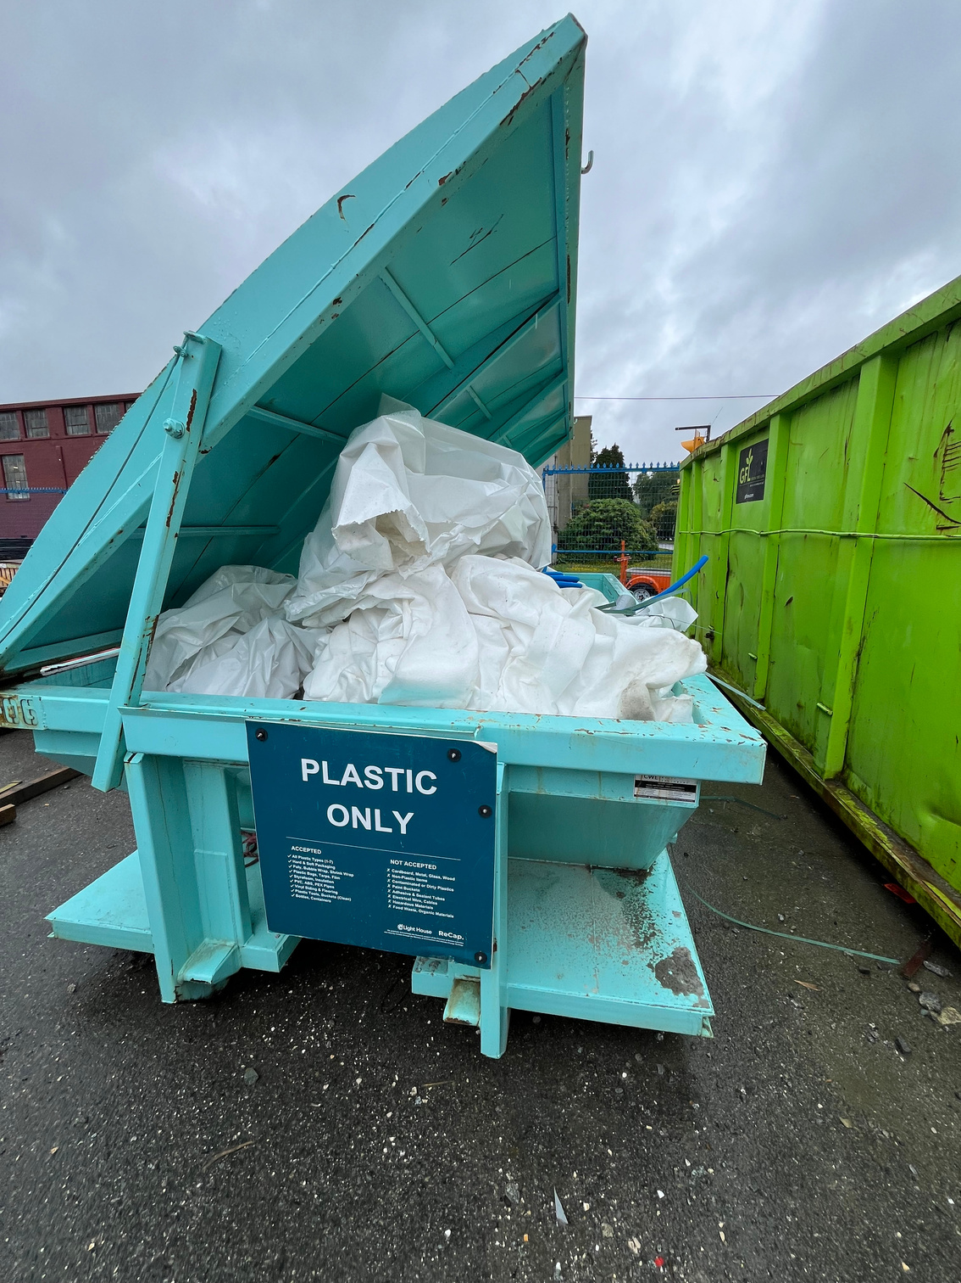
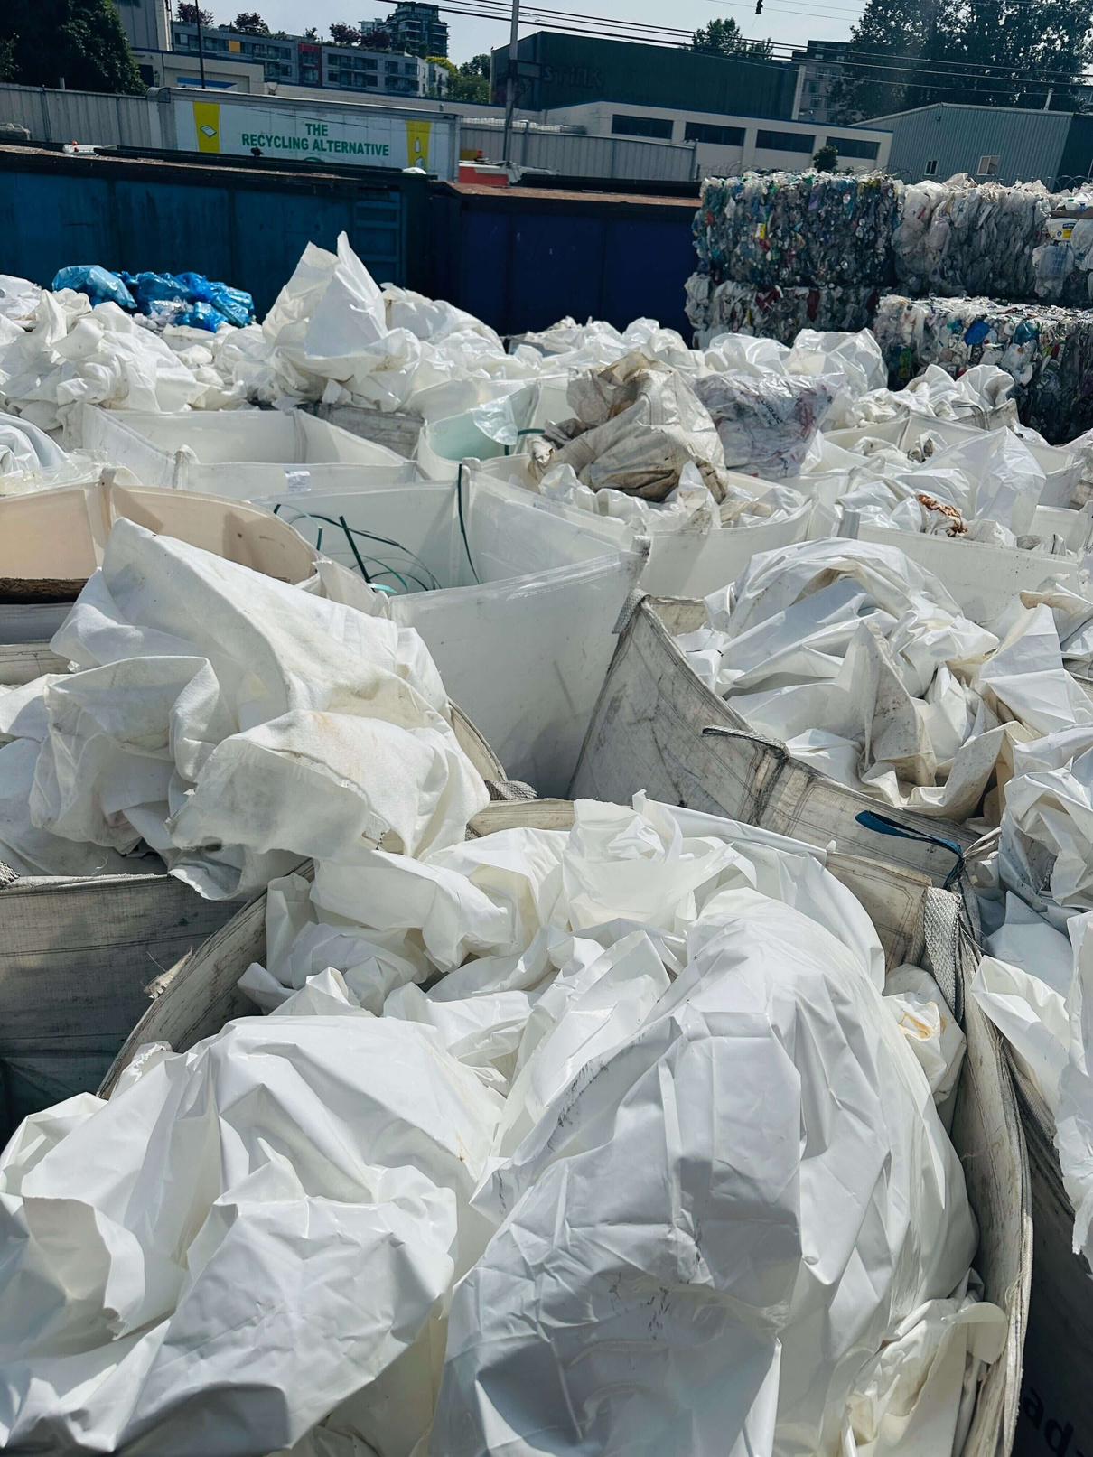

Slide 13
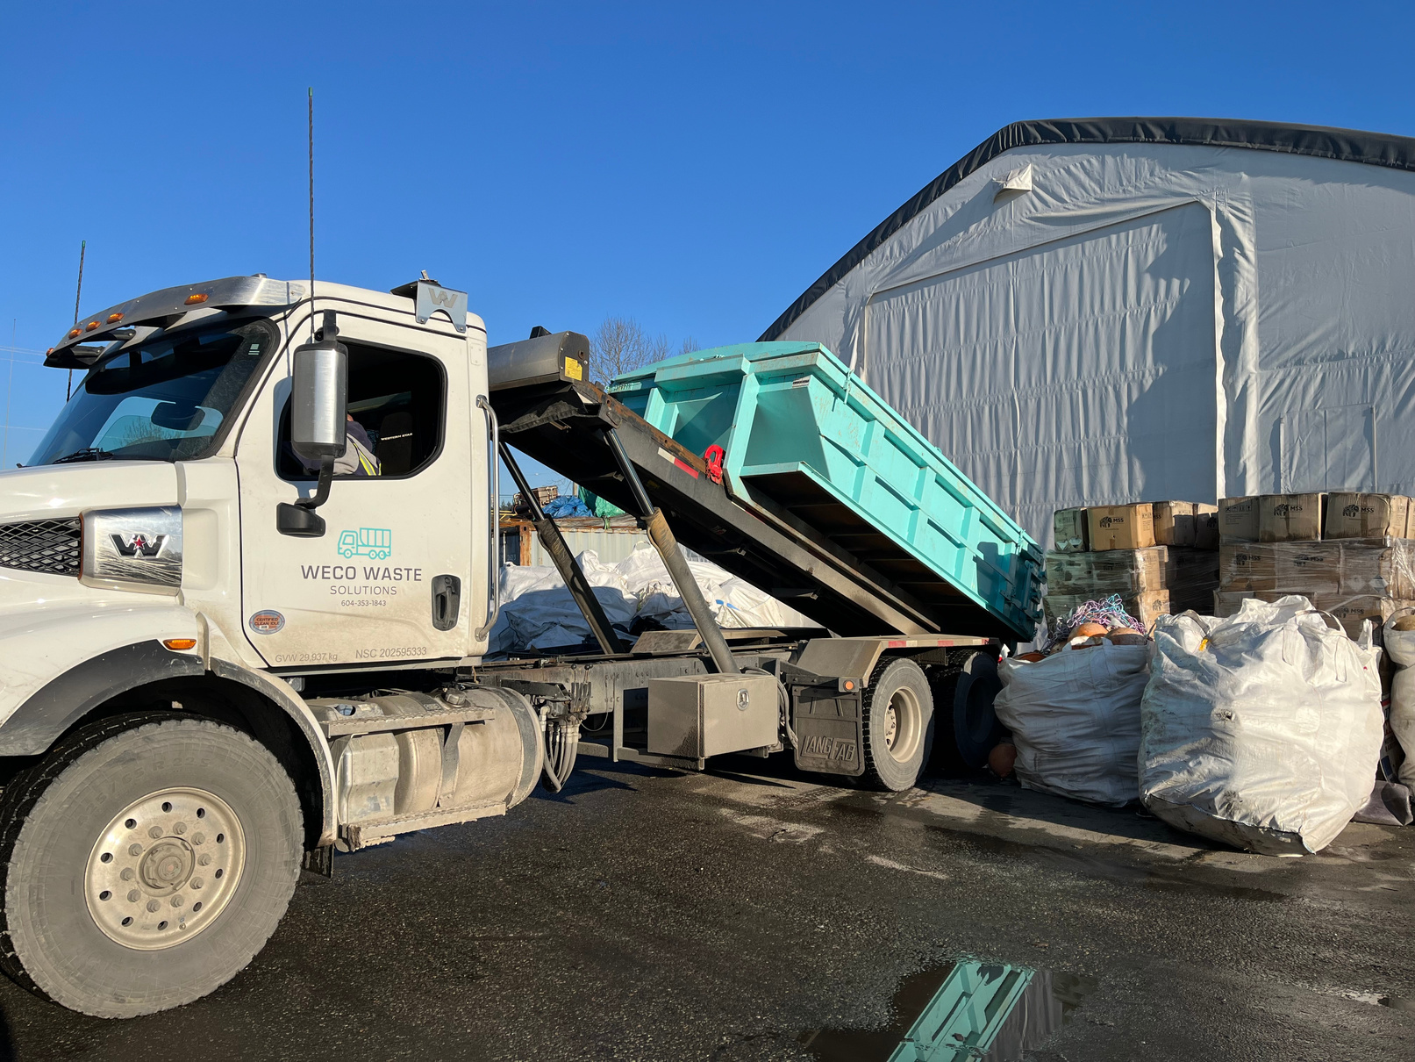
THE CPI PROCESS
Site monitor coordinated bin pickups and drop-offs, contamination monitoring

Slide 14
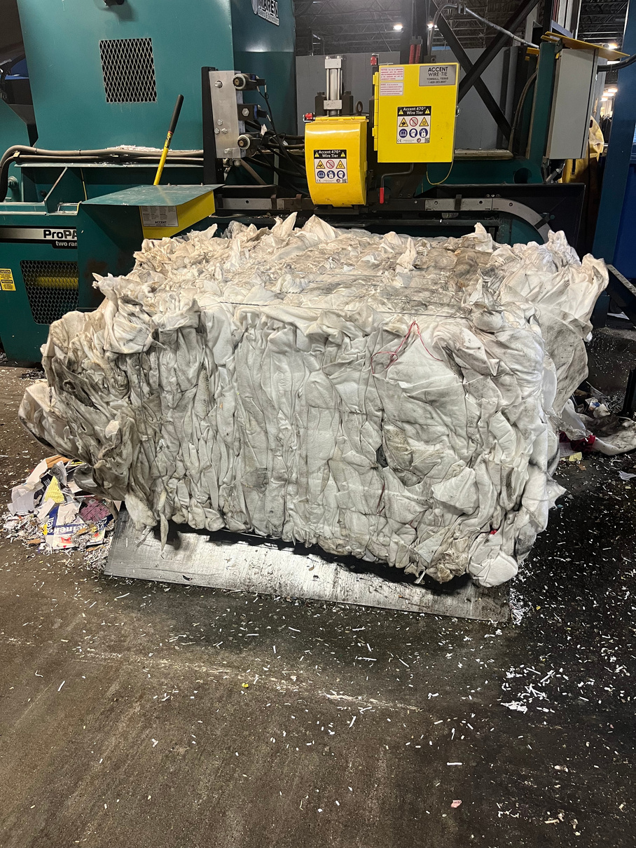
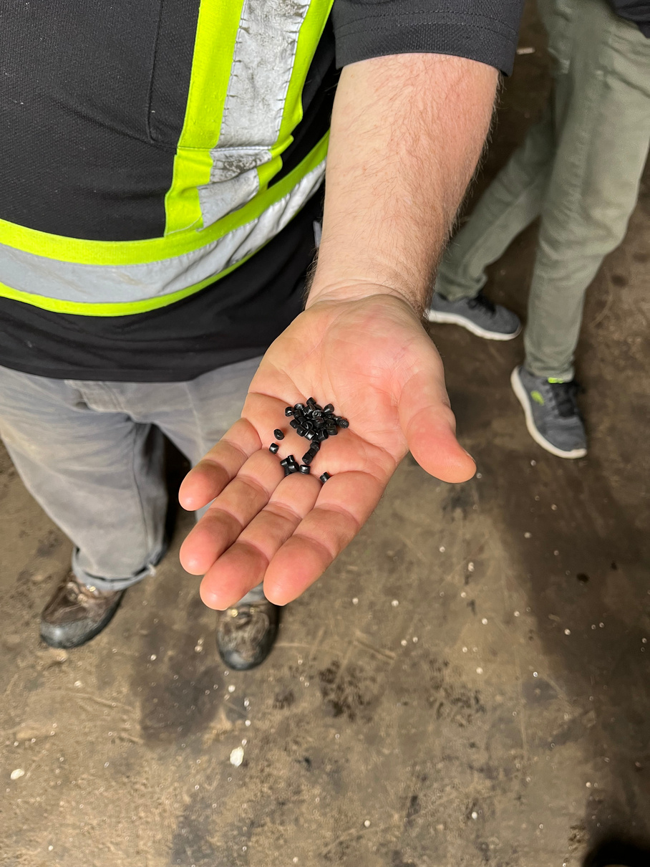
THE CPI PROCESS
Sorting done off site – materials identified, weighed, tracked and baled.
Select amount of material was sent for mechanical processing (extrusion).

Slide 15
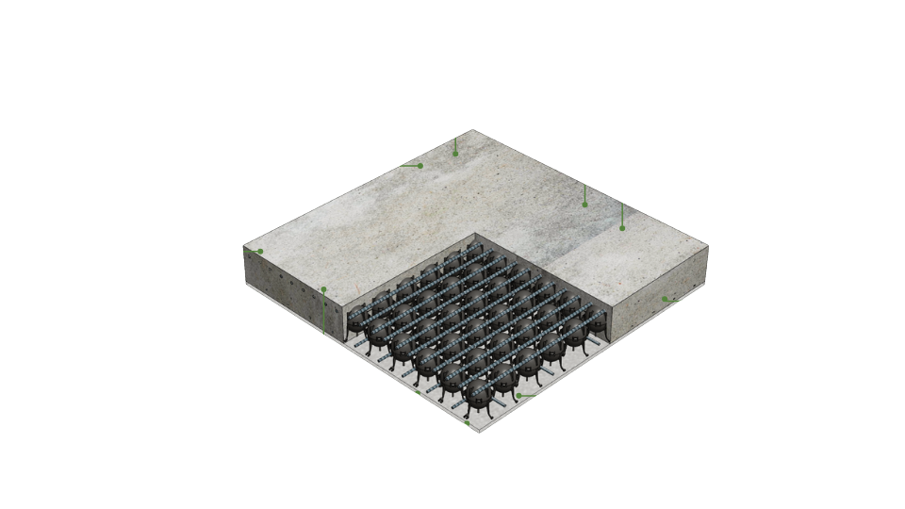
THE CPI PROCESS
Integrated into InfinaNet - an innovative patented concrete void system for concrete slabs in residential multi-unit applications

Slide 16
FINDINGS
16

Slide 17
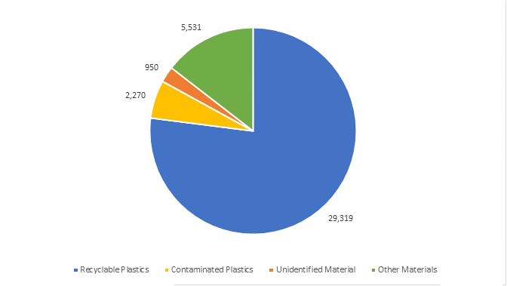
PLASTICS COLLECTED: 38,070KG
17

Slide 18
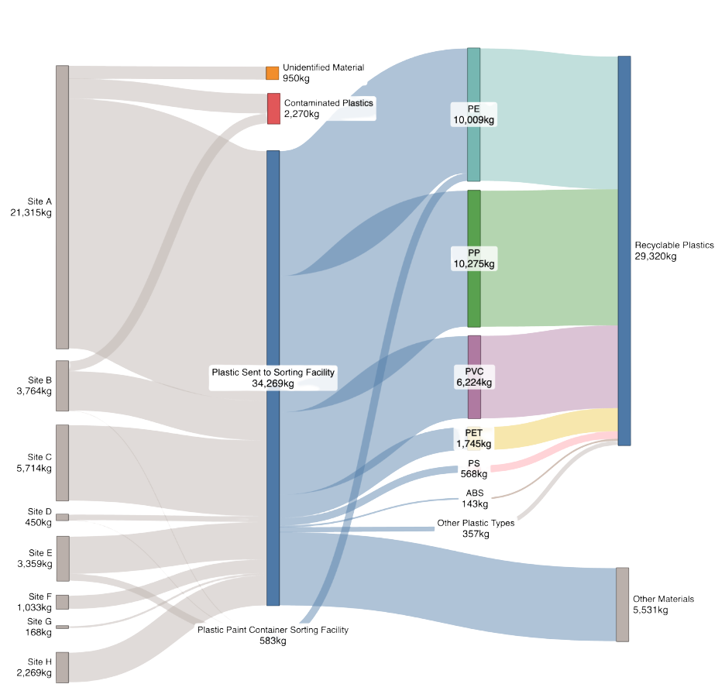
MATERIAL FLOWS
Construction plastics are recoverable and recyclable (77% was recovered)
18

Slide 19
FINANCIAL OBSERVATIONS
Central premise: System must be financially self-sustaining.
Finding: System can be financially sustainable at scale with appropriate policy and infrastructure in place.
19

Slide 20
FINANCIAL
  Report makes 29 recommendations, including policy reforms:
    Variable tipping fees for plastics
    Landfill bans on plastics
    Support development of plastic-reduction strategies, product innovation, processing technologies and infrastructure
  Federal Plastics Registry to require tracking and reporting of plastics in construction in 2027
20

Slide 21


CONSTRUCTION
PLASTICS
INITIATIVE
Thank you!
www.light-house.org/cpi
cpi@light-house.org
21

Slide 22
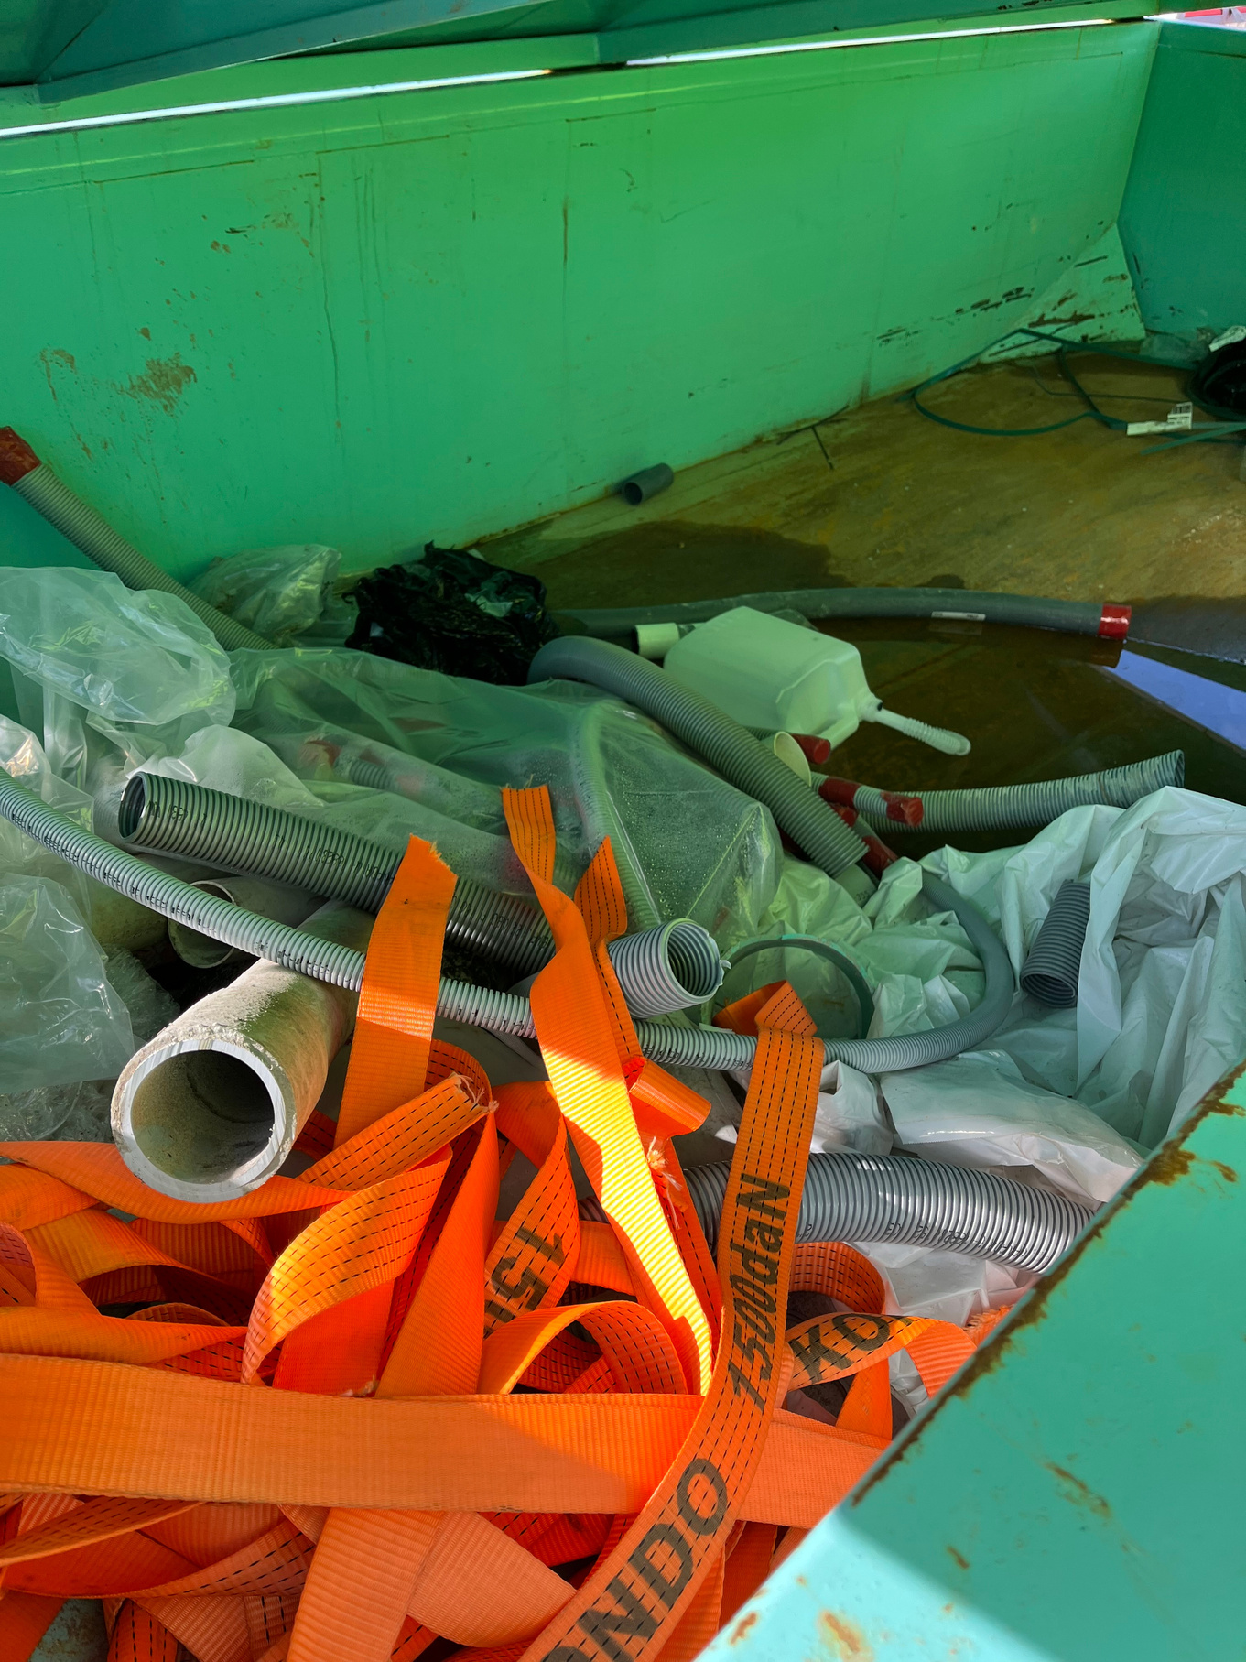
CONTAMINATION
  Approximately ~20%
  Contamination occurred primarily at specific construction phases
  Contamination levels dropped as crews became more familiar with the program and took pride in supporting the project’s objectives
22

Slide 23
FACTORS INFLUENCING CONTAMINATION RATES
  Bin Placement, Visibility, and Site Layout
  Mechanical Handling and Loading Practices
  Excavation, Early Works, and Wet Site Conditions
  Erosion & Sediment Control (ESC) and Mixed Material Plastics
  Material Size and Form
  Additional Handling and Pre Sorting
23

Slide 24
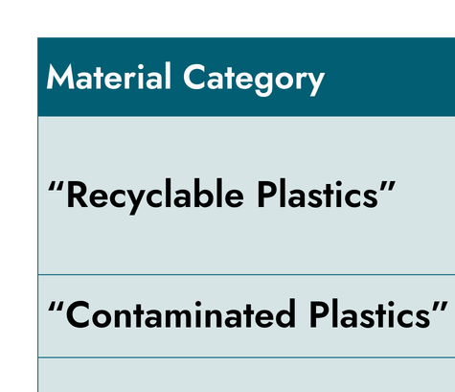
MATERIALS COLLECTED
24

