Slide 1
Insights from
to Keep Packaging in the Economy & Out of the Environment

Slide 2
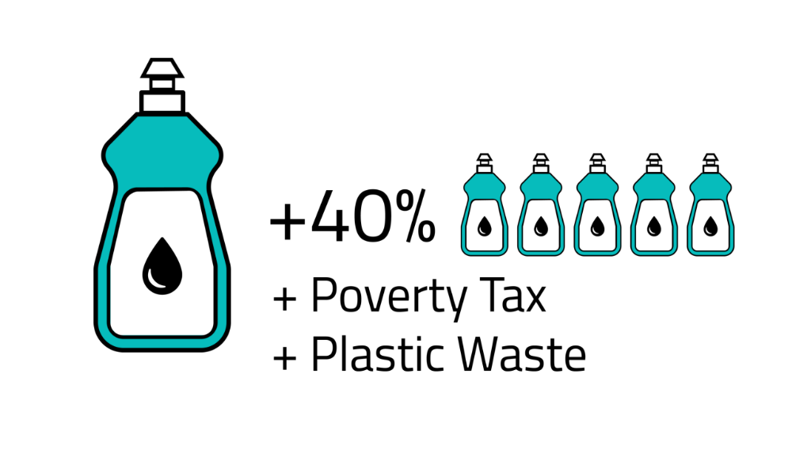
Innovative Solutions to Complex Market Failures

Slide 3
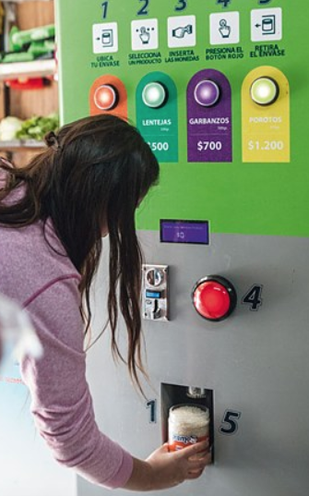
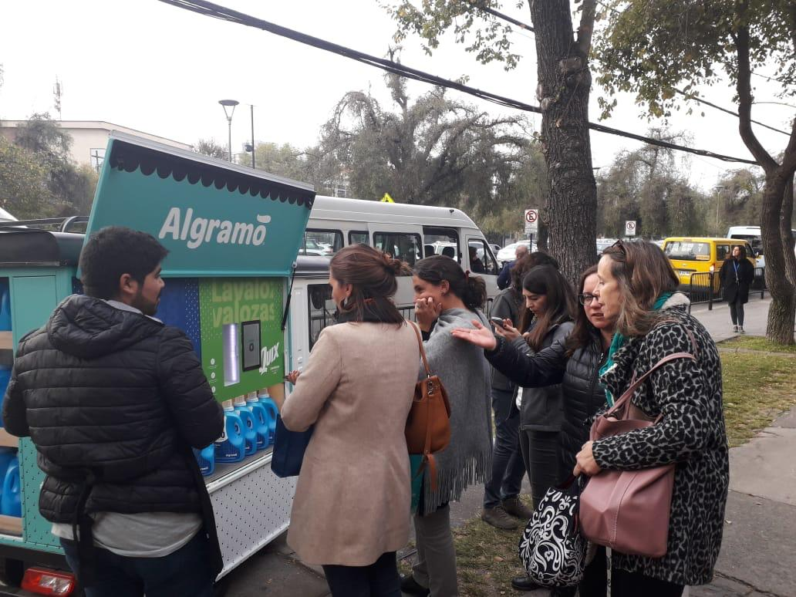
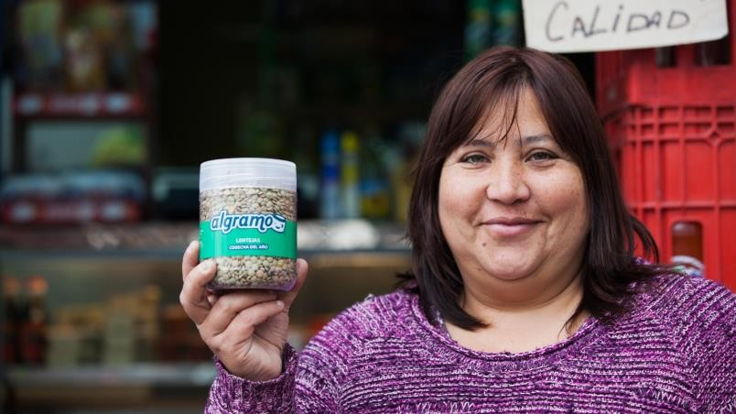
Algramo 1.0 2013-2018 basic vending machines & in store exchange reach 2,000 stores-350k customers <10% reuse to >85%
2018-2019 THE PIVOT: Leveraging past success to scaling reuse into global supply chains: Unilever, Nestle, Colgate, Coca-Cola Walmart, Target, Lidl

Slide 4
Algramo
What scaled well vs. what limited growth
What worked
What did not work
Clear value proposition: lower refill costs and less plastic waste 20% motivates
Early traction from dispensers and neighborhood retail created access to:
Partnerships with FMCGs and retailers
FMCG interest validated scalability potential to enable Venture Capital
Hardware-heavy rollout made expansion slower & operationally complex
Behavior change relies on consumer
Economic downturns make brands and customers focused on minimizing costs, packaging wars with cheap Doy Packs
FMCGs critical to justify VC investments
Simple message, familiar packaging icons, and visible savings made the concept easy to explain.
The concept was compelling, but scaling the system required more than strong branding alone.

Slide 5
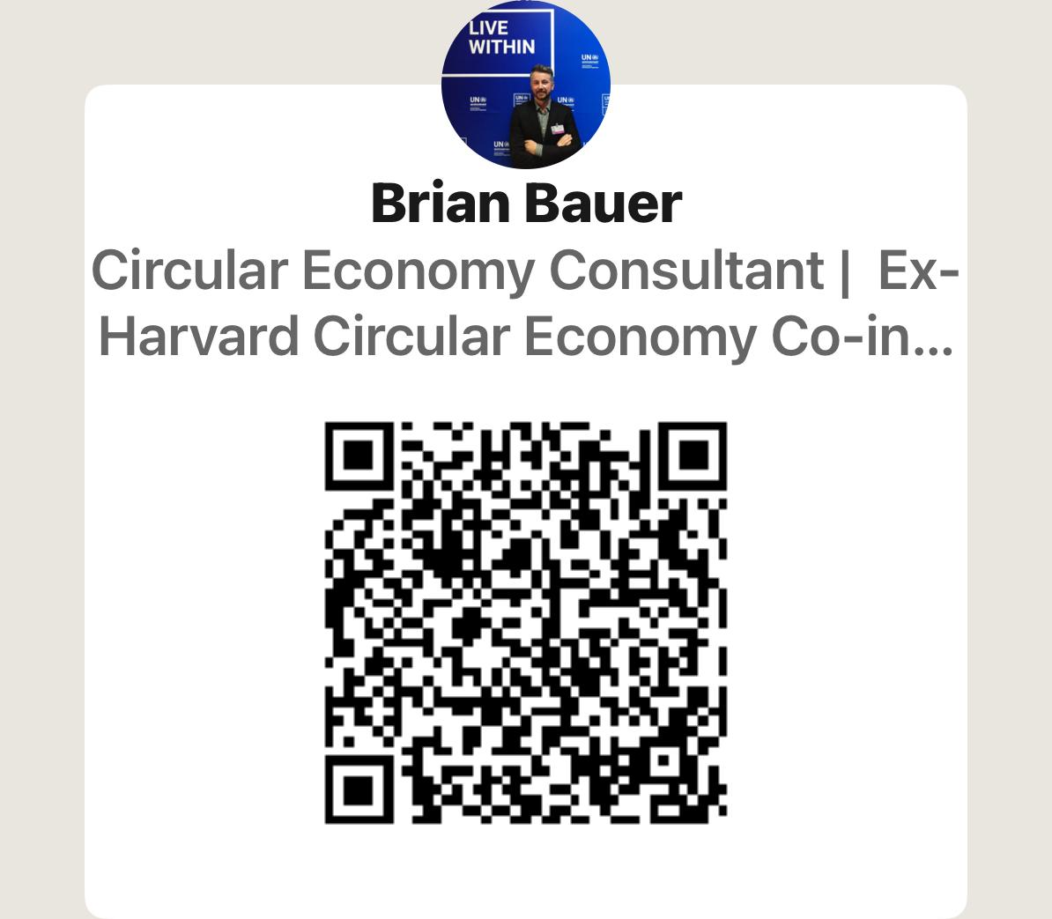
Policies to enable Reuse/Refill Systems
Key policy levers
Why policy matters
1
2
Scale
Reuse targets
EPR eco-modulation
(Level playing field)
Set binding category-level targets for reuse-with industry input
Policy reduces cost barriers to makes reuse easier to adopt system-wide
Lower fees for reusable formats and > fees for SU
THE ENABLERS:
Create a level playing field between single-use and reusable packaging
De-risk investment in reuse infrastructure, operations, and reverse logistics
Shift behavior by aligning price signals with waste prevention goals
Help brands/retailers move from pilots to repeatable operating models
3
4
Focus on Sectors with Industry Support
Standardized packaging & Infrastructure
Beverage, B2B & semi closed ecosystems to create shared infrastructure / demand – Infinity Box

