Slide 1
Lessons from Plastic Waste Policies in Japan
Misuzu ASARI
Research Institute for Humanity and Nature
Kyoto, Japan

Slide 2
Summary of presentation
In Japan, a unique waste management system has been established since the end of WWII. In particular, household waste has relied heavily on incineration.
Amidst this, the enactment of recycling laws targeting individual products progressed, starting with the Container and Packaging Recycling Law, which came into effect in 1995. While EPR is being implemented in various forms tailored to the characteristics of each product, there are persistent criticisms that it is insufficient.
Regarding plastics, they are covered to a certain extent by the Container and Packaging Recycling Law of 1995, and plastic recycling has also progressed under laws such as the Home Appliance Recycling Law. Furthermore, in 2022, Plastic Resource Recycling Promotion Law, which focuses on materials, came into effect.
In Japan, much of the collected waste/recycled plastic has been exported, but recently, the importance of domestic resource recycling has been emphasized. Although the recycling rate and quality are not yet high, it is attracting attention as a field that is evolving rapidly.

Slide 3
Plastic Flow in Japan
Edited from Plastic Waste Management Institute JAPAN (2023)
Disposal and recovery
Mechanical recycling 74
Chemical use 26
Gasification 3
Fuel 34
Incineration with energy recovery 202
Without energy recovery 38
Landfilling 11
Resin production and processing
Discharge
Resin production
887
Total Plastic
Waste 769
Domestic products consumption
843
Domestic plastic input
832
Post-use products discharge
710
Domestic
Domestic waste
387
Resin
export
import
Product
Export
Import
Waste
Mechanical recycling 97
Chemical use 1
Gasification 11
Fuel 161
Incineration with energy recovery 80
Without energy recovery 20
Landfilling 12
Industrial waste
382
Production & processing waste
58
Industrial
Reclaimed products
48
Mechanical recycling 22%
Incineration with energy recovery 37%
Incineration without energy recovery 8%
Fuel (densified-refuse derived fuel/cement material) 27%

Slide 4
Basic Environment Act (enacted Nov.1993)
Basic Environment Plan
(enacted Nov.1993, revised approximately every five years.)
The Basic Act for Establishing a Sound Material-Cycle Society (aka. Basic Framework Act) (enacted May 2000)
Goal: To ensure material-cycle society, control consumption of natural resources, and reduce environmental load
The Fundamental Plan for Establishing a Sound-Material Cycle Society
(enacted Mar.2003, revised approximately every five years.)
Appropriate waste treatment
Promotion of recycling
Waste Management Act (enacted Dec.1970)
Effective Resource
Utilization Promotion Act (enacted Apr.1991)
Waste generation control
Appropriate waste treatment (including recycling)
Regulation on the establishment of waste management facilities
Regulation on waste management operators
Establishment of waste management standards, etc.
Recycling of reusable resources
Development of easy-to-recycle
structures and materials
Labeling for sorted waste collection
Promotion of the effective use of by-products
 |  | Reduce
Recycle | → | Reuse
(1R) |  | Recycle
 |  | (3R)
Acts in accordance with the properties of individual products and materials
Containers and Packaging
Recycling Act
(enacted Jun.1995)
Home Appliance Recycling Act
(enacted May 1998)
Food Recycling Act
(enacted May 2000)
Construction Recycling Act
(enacted May 2000)
Automobile
Recycling Act
(enacted Jul.2002)
Small Home Appliance
Recycling Act
(enacted Aug.2012)
Plastic Resource Circulation Act
(enacted Apr.2022)
Bottles (glass/PET), Containers (paper/plastic), etc.
Air conditioners,
Refrigerators, Freezers,
Washing/Drying Machines , TVs
Food waste
Wood,
Concrete,
Asphalt, etc.
End-of-life vehicles
Small electronic
devices, etc.
Plastic products,
Single-use plastics, etc.
Supported by Green Procurement Act (enacted May 2000)

Slide 5
Acts in accordance with the properties of individual products and materials
Plastic related
Containers and Packaging
Recycling Act
(enacted Jun.1995)
Home Appliance Recycling Act
(enacted May 1998)
Food Recycling Act
(enacted May 2000)
Construction Recycling Act
(enacted May 2000)
Automobile
Recycling Act
(enacted Jul.2002)
Small Home Appliance
Recycling Act
(enacted Aug.2012)
Plastic Resource Circulation Act
(enacted Apr.2022)
Bottles (glass/PET), Containers (paper/plastic), etc.
Air conditioners,
Refrigerators, Freezers,
Washing/Drying Machines , TVs
Food waste
Wood,
Concrete,
Asphalt, etc.
End-of-life vehicles
Small electronic
devices, etc.
Plastic products,
Single-use plastics, etc.

Slide 6
EPR for individual products
▼PR in each act
▼Characteristics
 | Payment of recycling costs (only) | Municipalities collect the waste. Businesses pay the recycling fees.
 | Obligation to collect and recycle | Appliance manufacturers are responsible for recycling. Consumers pay the recycling fees.
 | Separate dismantling and recycling of specific construction materials | Construction companies are required to sort and recycle waste.
 | Collection and recycling of shredder dust, airbags, and fluorocarbons | Producers and importers are responsible for proper disposal. Consumers pay the disposal fees.
 | Promoting separate waste collection and recycling (only) | Manufacturer obligations are limited. Collection is primarily handled by municipalities (recycling by certified businesses).
Containers and Packaging
Recycling Act
Bottles (glass/PET), Containers (paper/plastic)
Home Appliance Recycling Act
Air conditioners,
Refrigerators, Freezers,
Washing machines, TVs
Construction Recycling Act
Wood,
Concrete,
Asphalt, etc.
Automobile
Recycling Act
End-of-life vehicles
Small Home Appliance
Recycling Act
Small electronic
devices, etc.

Slide 7
Japanese Plastic Resource Circulation Strategy (2019) compared with Canada and G7
 | Japan | Canada | G7, Ocean plastic charter
Reduce | By 2030, reduce emissions of single-use plastics such as containers and packaging by 25% (cumulative). | Reduce the use of microbeads and microplastics. | Significantly reduce unnecessary use of single-use plastics, considering the environmental impacts of alternatives.
Reuse and recycling | By 2025, ensure that plastic containers, packaging, and products are designed to maintain functionality while being technically easy to sort, reuse and recycle. Where alternatives are not available, allow energy recovery. | By 2030, achieve 100% reusability, recyclability, or recoverability. | By 2030, ensure 100% of plastics are reusable or recyclable. Where alternatives are not available, allow energy recovery.
 | By 2030, 60% of plastic containers and packaging to be recycled or reused. | By 2030, at least 55% of plastic containers and packaging to be recycled or reused. | By 2030, at least 55% of plastic containers and packaging to be recycled or reused.
 | By 2035, achieve 100% effective utilization of all used plastics, including energy recovery. | By 2030, achieve a 50% recycling rate. | By 2040, achieve 100% effective utilization of all plastics, including energy recovery.
 | By 2030, double the material recovery of plastic waste. |  | By 2030, increase the use of recycled content in plastic products by at least 50%.
Renewable | By 2030, introduce biomass plastics to the maximum extent (2 million tonnes). |  | ―

Slide 8
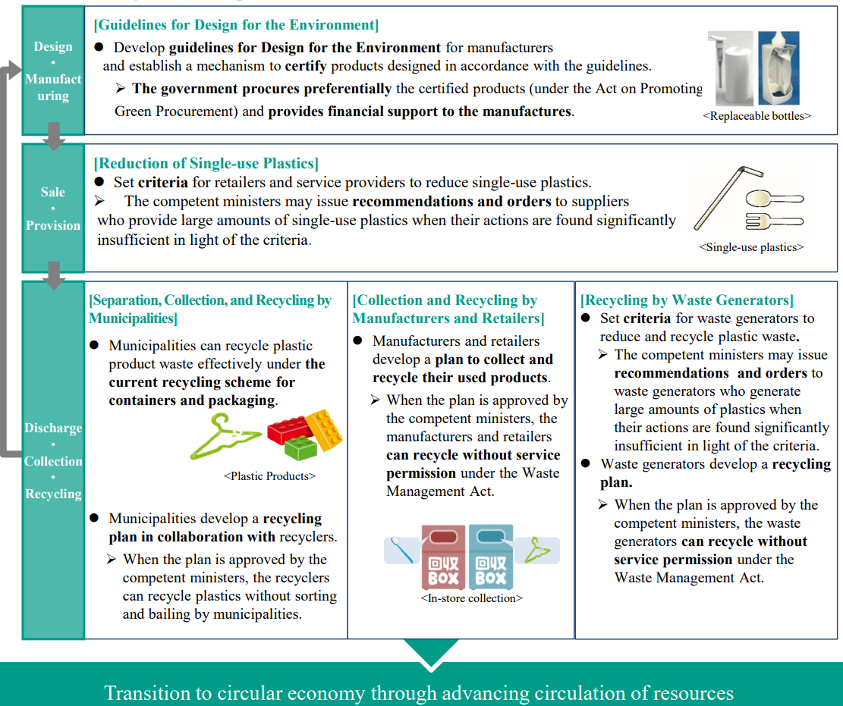
Measures along life cycle of plastics under the Plastic Resource Circulation Act
Design & manufacturing
Sale & provision
Discharge, collection & Recycling

Slide 9
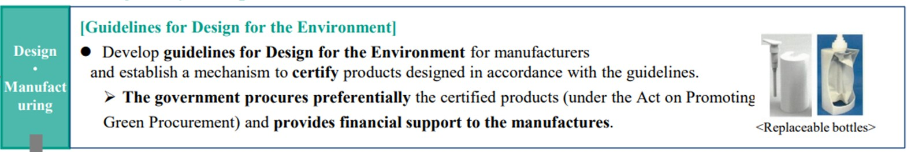

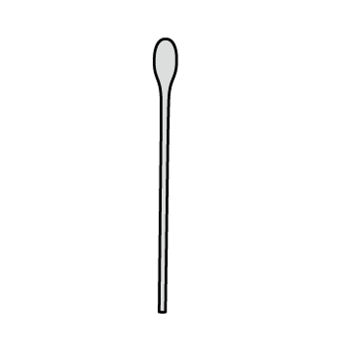
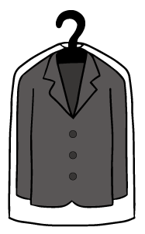
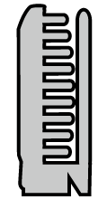

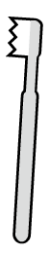


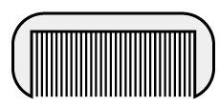
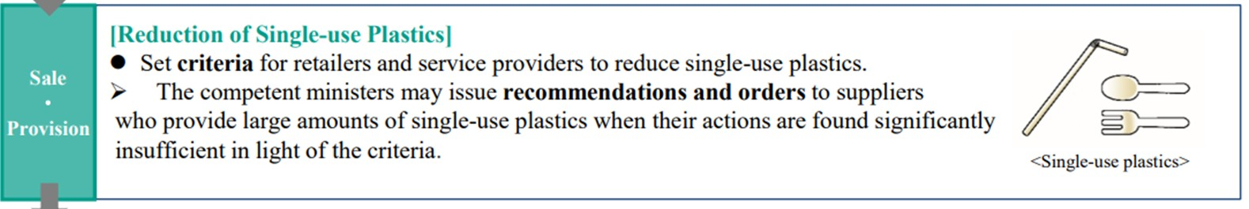
Measures along life cycle of plastics under the Plastic Resource Circulation Act
For stationery, beverage PET bottles, household detergent containers, cosmetic containers, guidelines has been established.
Design & manufacturing
Sale & provision
12 products are targeted.

Slide 10
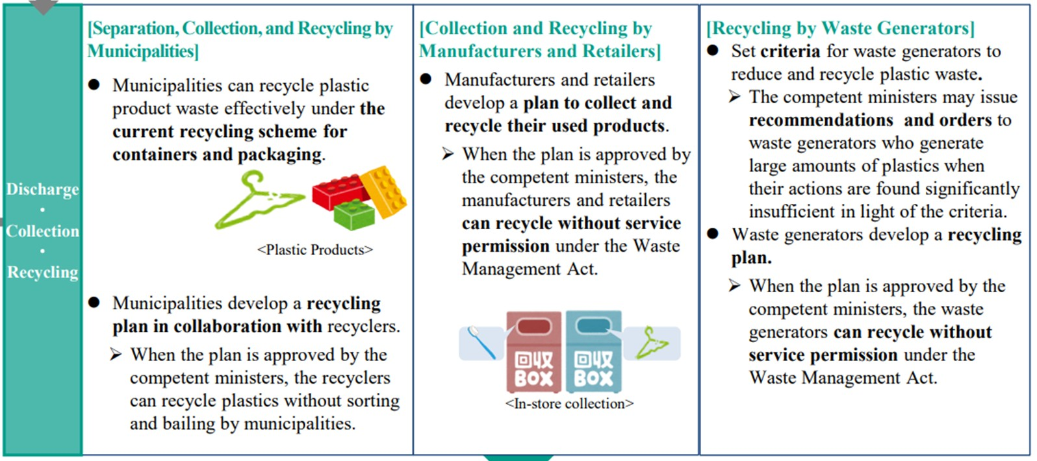
Measures along life cycle of plastics under the Plastic Resource Circulation Act
Discharge, collection & Recycling

Slide 11
Limitation of EPR in Japan (personal opinion)
In Japan, the automotive and home appliances industries have held considerable power. When enacting recycling laws targeting individual products, the Ministry of the Environment (MOE), which is responsible for such laws, faced difficulties in negotiations with the Ministry of Economy, Trade and Industry (METI) and industry associations. As a result, only a minimal mandatory EPR (Expertise-Based Review) has been achieved. In some cases, no target values ​​are set for the amount of waste collected.
On the other hand, in Japan, there is a strong sense of diligence in achieving laws and goals set by the government.
While there is a culture of resistance to intervention within the Japanese business community, Keidanren (Japan Business Federation) and industry associations are conducting some studies and are making progress on voluntary initiatives. However, there are few practical examples of EPR.

Slide 12
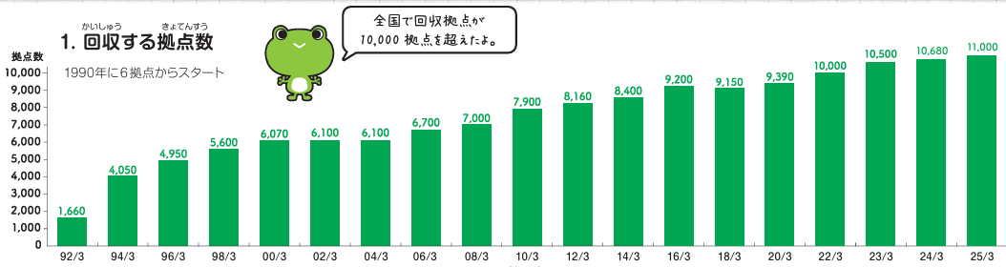
Good example: in-store collection and recycling by food tray manufacturer “FPCO”
FPCO, Japan's largest food tray manufacturer, started its own recycling program in 1990. Following the widespread boycott of McDonald's plastic containers in the US, they decided to implement EPR.
They install collection boxes at supermarkets, collecting food trays, including those from other companies, and recycling them at their own factories, using them again as raw materials for new trays.
Currently, they have over 11,000 locations for collection.
Number of collection locations

Slide 13
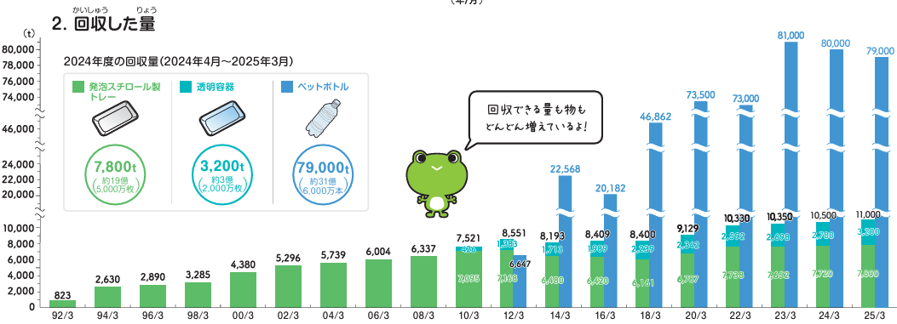
Collection amounts
As the program expanded, the types and quantities of items collected also increased. Currently, the collection rate for food trays is approximately 30%.
This is a prime example of success made possible by the decisive action of CEO, the cooperation of all parties involved, and favorable conditions (such as the ability to recover the trays on the return trip after delivery).

Slide 14

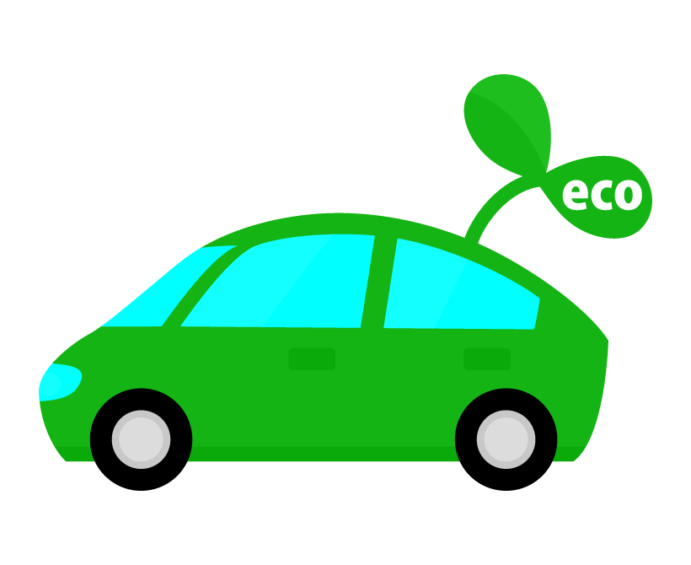


Plastic collection and recycling are attracting attention!
In a large-scale project focused on the circular economy, the goal is to thoroughly collect plastic and create a demonstration car using only recycled plastic.
The background to this is the EU's mandatory use of recycled plastics in new cars. The automotive industry has changed its approach and is beginning to tackle the issue with renewed determination.
A network focused on promoting plastic recycling through collaboration between the arterial and venous industries.

Slide 15
Possibility of EPR in Japan (personal opinion)
In Japan, the strong influence of the business community makes it difficult to implement robust EPR.
However, as seen in the automotive industry, there is a possibility that efforts will accelerate in response to global pressure.
While examples like FPCOs are rare, they may attract renewed attention if the effects of a blockade of the Strait of Hormuz become prolonged.
Furthermore, changes in consumer awareness and behavior could also provide a boost. However, unfortunately, awareness among Japanese people is currently low, making educational approaches and collaboration with the media crucial.

Slide 16
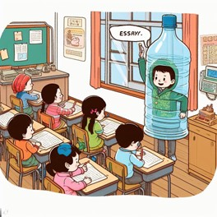
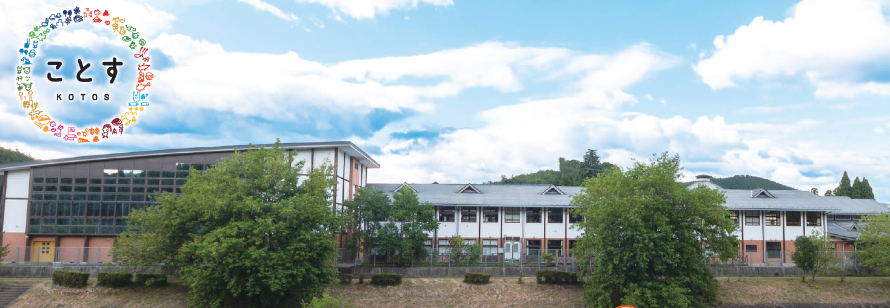
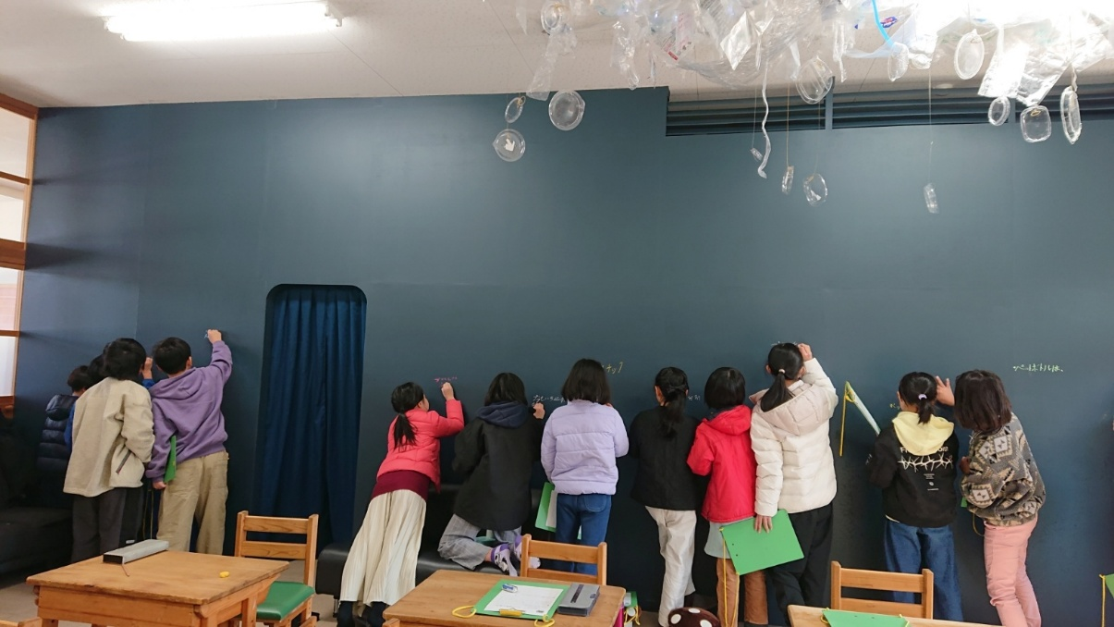
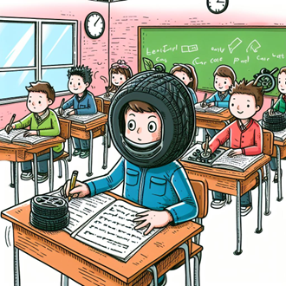
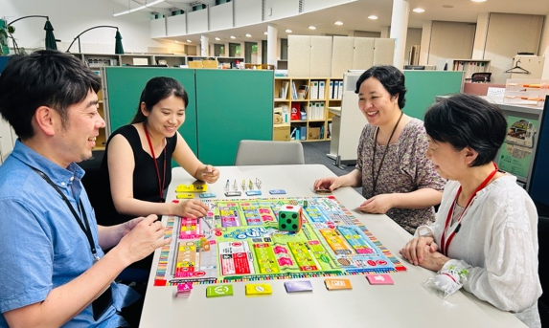
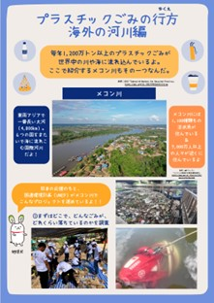
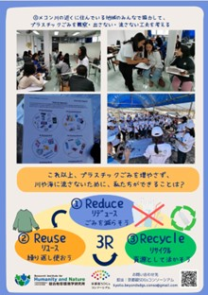
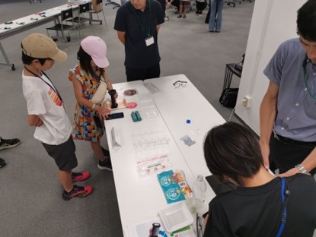
Program change awareness that plastic is a valuable resource
◆A closed school facility where students can learn about and experience a sustainable relationship with plastics in a variety of ways.
Kyoto Satoyama SDGs Lab
(Keihoku, Ukyo-ku, Kyoto)
◆Development & effectiveness testing of a feeling game (provisional) in Pla.
◆UNEP Collaboration Programme
◆ Collaboration with companies

